Slide 1
Regression of cirrhosis during treatment with tenofovir disoproxil fumarate for chronic hepatitis B: a 5 year open-label follow-up study

Slide 2
Overview hepatitis B
Worldwide estimated 350 million people
250.000 to 650.000 chronic virus carrier in Germany
Chronic, if
there is a symptomatic liver infection and
the viral marker remains detectable in blood for more than 6 months
15-40 % of patients with chronic HBV
Progression to cirrhosis, liver failure or HCC

Slide 3
Aims of study
Evidence of an association between long-term suppression of HBV replication and regression of liver fibrosis
Inclusion criteria:
Patients with chronic HBV infection
Substance: Tenofovir = Reverse-transcriptase inhibitor

Slide 4
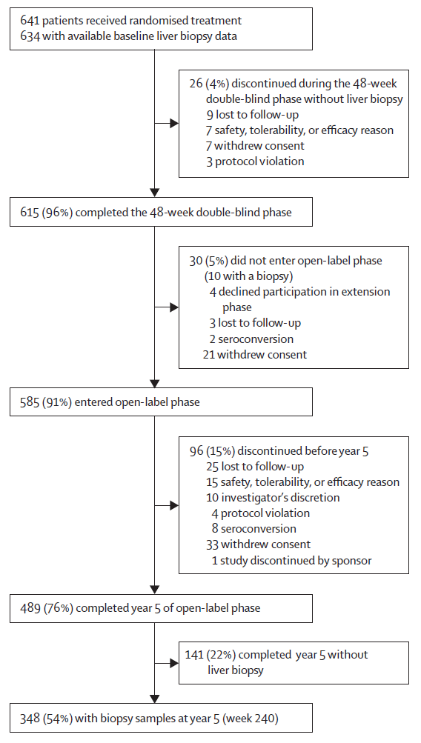
Structure of study
641 Patienten received randomisied treatment with adefovir or tenofovir for 1 year
634 with available baseline liver biopsy data
585 entered open label phase – treatment with tenofovir
348 useful biopsy samples at year 5 of open label phase

Slide 5
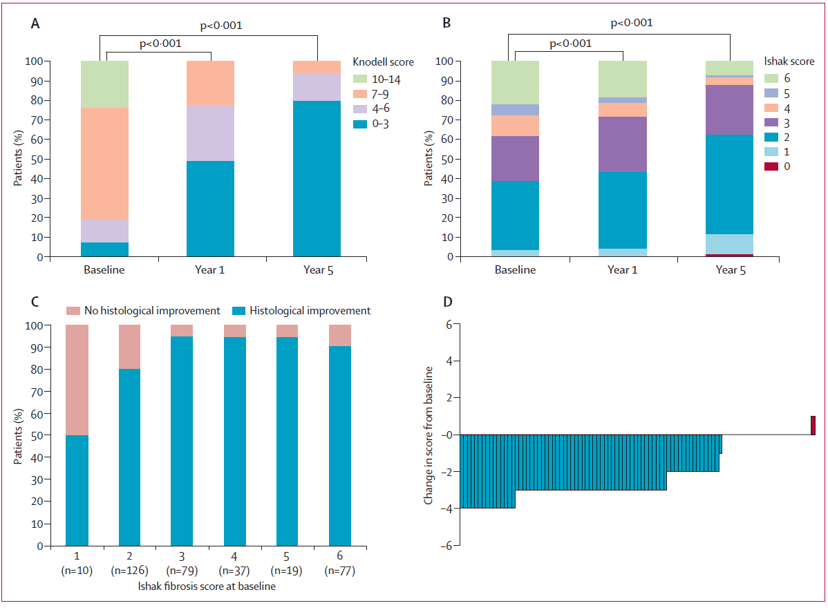
Results
Knodell Score
Score 3 or less indicate mild or no necroinflammation
Score 10 or above pronounced necroinflammation
Ishak Score
Score 0 indicates absence of fibrosis
Score 5 or more indicates cirrhosis

Slide 6
96 patients had cirrhosis (Ishak score ≥ 5) at baseline
71 (74 %) were no longer cirrhotic at year 5
≥ 91% of patients with Ishak score ≥ 2 had histological improvement
High response to tenofovir treatment
Viral suppression in 99% of patients
with long-term therapy
No resistance-associated mutations
were detected
Low frequency of adverse events

Slide 7
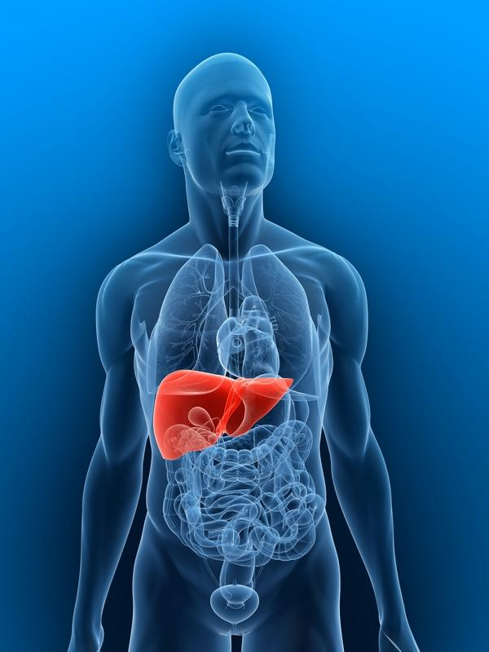
Take Home Message
Tenofovir
Long-term suppression of HBV can lead to regression of fibrosis and cirrhosis
Highest effects in patients with advanced
fibrosis and cirrhosis (Ishak Score ≥ 2)
Maintains viral suppression in majority
of patients with HBV
Well tolerated – low rate of adverse events

Slide 8
Thank you for your attention.
Are there any questions?

