Slide 1
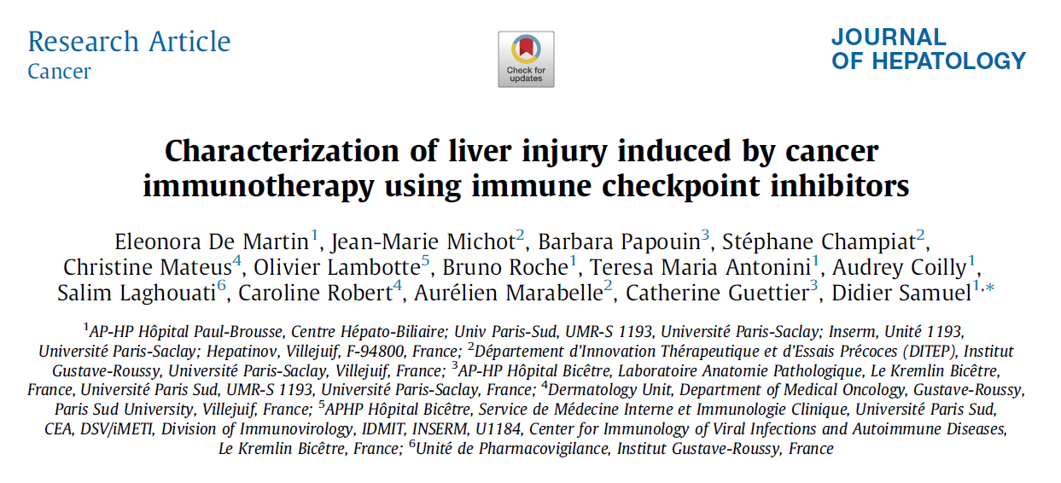
S. Bauer Journal club, 19.07.2018

Slide 2
Background
The immune checkpoint pathways permit to downregulate immune functions
Immune checkpoint pathways targeted by cancer cells lead to a tolerance of the immune system toward cancer cells
The immune checkpoint inhibitors (ICIs) have revolutionized cancer treatment by the restoration of functional T cell responses yielding tumor destruction by the immune system and improved clinical outcomes
Notes:
Ipilimumab, a human Ig-G1 mAb, blocks cytotoxic T lymphocyte antigen 4 (CTLA-4).
Pembrolizumab and nivolumab, humanized IgG4 kappa and human IgG4 mAbs, respectively, block the interaction between programmed cell death protein 1 (PD-1) and the two PD ligands, PD-L1 and PD-L2, by selectively binding the PD-1 receptor.
Durvalumab, a human IgG1 kappa mAb, targets PD-L1.
Checkpoint inhibitors such as anti-programmed cell death 1 (PD-1) (pembrolizumab, nivolumab), anti-PD ligand 1 (PD-L1) (avelumab, durvalumab and atezolizumab) and anti-cytotoxic T-lymphocyte antigen 4 (CTLA4) (ipilimumab) antibodies have revolutionized cancer treatment especially in melanoma, by the restoration of functional T cell responses, yielding tumor destruction by the immune system and improved clinical outcomes.

Slide 3
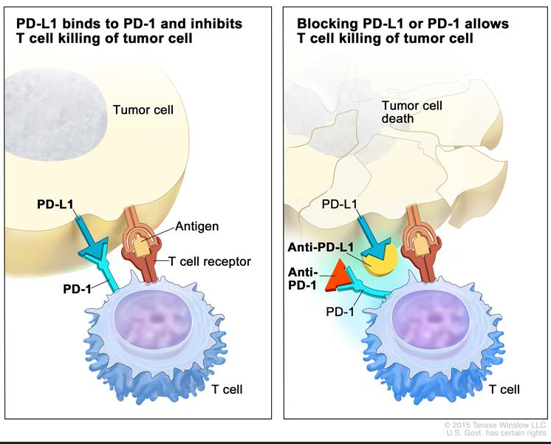
PD-1: programmed cell death protein 1
PD-L1: programmed cell death protein ligand 1
https://www.cancer.gov/types/skin/patient/melanoma-treatment-pdq#section/all
Notes:
Ipilimumab, a human Ig-G1 mAb, blocks cytotoxic T lymphocyte antigen 4 (CTLA-4).
Pembrolizumab and nivolumab, humanized IgG4 kappa and human IgG4 mAbs, respectively, block the interaction between programmed cell death protein 1 (PD-1) and the two PD ligands, PD-L1 and PD-L2, by selectively binding the PD-1 receptor.
Durvalumab, a human IgG1 kappa mAb, targets PD-L1.
Checkpoint inhibitors such as anti-programmed cell death 1 (PD-1) (pembrolizumab, nivolumab), anti-PD ligand 1 (PD-L1) (avelumab, durvalumab and atezolizumab) and anti-cytotoxic T-lymphocyte antigen 4 (CTLA4) (ipilimumab) antibodies have revolutionized cancer treatment especially in melanoma, by the restoration of functional T cell responses, yielding tumor destruction by the immune system and improved clinical outcomes.

Slide 4
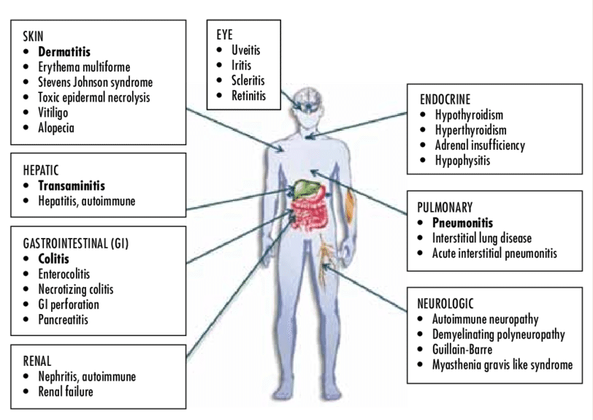
Immune-related adverse events
Brigden M et al. OE. Vol. 15, NO. 3, august 2016.

Slide 5
Aim of the study
To compare hepatic immune-related adverse events (IRAEs) associated with anti-programmed cell death protein 1 (PD-1)/PD-ligand 1 (PD-L1) and anti-cytotoxic T lymphocytes antigen 4 (CTLA-4) monoclonal antibodies (mAbs).
Notes:
Outcomes: To investigate the causal relationship between the immunotherapy and hepatic IRAEs
article description
Immunotherapy for metastatic cancer can be complicated by the onset of hepatic immune-related adverse events (IRAEs). This study compared hepatic IRAEs associated with anti-programmed cell death protein 1 (PD-1)/PD ligand 1 (PD-L1) and anti-cytotoxic T lymphocyte antigen 4 (CTLA-4) monoclonal antibodies (mAbs).

Slide 6
Material and Methods
Design:
Prospective study
Setting:
Pharmacovigilance register focused on the adverse events of anti-PD-1, anti-PD-L1 and anti-CTLA-4 immunotherapy
Outcomes:
To propose a comprehensive clinical and pathological description of the hepatic IRAEs associated with ICIs
To compare the patterns observed with anti-PD-1/PD-L1 and anti-CTLA-4 treatments
Patients:
All patients treated with ICIs for metastatic cancer who developed grade ≥3 hepatitis (cytolysis and/or cholestatsis >5x, bilirubine >3x ULN) and who were referred to the Liver Center, Hospital Paul Brousse, Villejuif, France
All referred patients underwent extensive hepatological work-up and a liver biopsy
Notes:
Setting: pharmacovigilance register focused on the adverse events of anti-PD-1, anti-PD-L1 and anti-CTL-4 immunotherapy
Patients: All patients treated with immune checkpoint inhibitors for metastatic cancer who developed grade ≥3 hepatitis, according to the Common Toxicity Criteria for Adverse Events (CTCAE) of the National Cancer Institute using version 4.03.
Acute grade ≥3 hepatitis according to CTCAE system (cytolysis and/or cholestatsis >5x, bilirubine >3x ULN)

Slide 7
ICIs therapy:
Anti-PD-1 (nivolumab) + anti-CTLA-4 (ipilimumab) every 3 weeks (4x), followed by nivolumab every 2 weeks
Anti-CTLA-4 (ipilimumab) every 3 weeks (4x)
Anti-PD-1 (nivolumab) every 2 weeks
Anti-PD-1 (pembrolizumab) every 3 weeks
Anti-PD-L1 treatments (durvalumab) every 4 weeks
Histological evaluation:
Histological features: portal fibrosis according to the METAVIR classification (F0–F4), portal inflammation (0–3), interface hepatitis according to the METAVIR classification (0–3), lobular inflammation (0–3), type of inflammatory infiltrates, lobular necrosis (spotty or confluent, with percentage and distribution), steatosis (percentage)
Immunostaining for CD3, CD4, CD8, FOXP3, ETS-related antigen (ERG), PD1, and PDL-1 was performed in an automatic immunostainer (Bond III, LEICA, 92737 Nanterre, France)
-> A principal pattern of liver injury was defined for each patient
Statistical analysis:
Mann–Whitney U test for continuous variable
Chi-squared test with Fisher’s correction for categorical variables
Notes:
Statistiques:
Le test de Wilcoxon-Mann-Whitney (ou test U de Mann-Whitney ou encore test de la somme des rangs de Wilcoxon) est un test statistique non paramétrique qui permet de tester l'hypothèse selon laquelle la distribution des données est la même dans deux groupes.
Le test exact de Fisher est un test statistique exact utilisé pour l'analyse des tables de contingence. Ce test est utilisé en général avec de faibles effectifs mais il est valide pour toutes les tailles d'échantillons. C'est un test qualifié d'exact car les probabilités peuvent être calculées exactement plutôt qu'en s'appuyant sur une approximation qui ne devient correcte qu'asymptotiquement comme pour le test du χ 2 {\displaystyle \chi ^{2}} utilisé dans les tables de contingence
Histo: Immunostaining for CD3, CD4, CD8, FOXP3, ETS-related antigen (ERG), PD1, and PDL-1 was performed in an automatic immunostainer (Bond III, LEICA, 92737 Nanterre, France) on de-paraffinised sections of the 16 biopsies. The antibodies,
clones, dilutions, and sources are listed in Table S3.

Slide 8
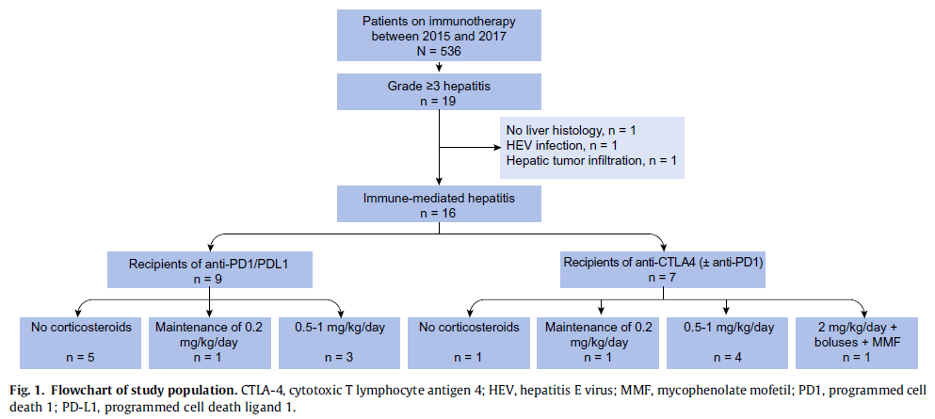
Results
Among 536 patients treated with anti-PD-1/PD-L1 or CTLA-4 immunotherapies, 19 (3.5%) were referred to the liver unit for grade ≥3 hepatitis.
Notes:
Of these patients, nine had received anti-PD-1/PD-L1 and seven had received anti-CTLA-4 mAbs, in monotherapy or in combination with anti-PD-1. Liver investigations were undertaken in these 16 patients, including viral assays, autoimmune tests and liver biopsy, histological review, and immunostaining of liver specimens.

Slide 9
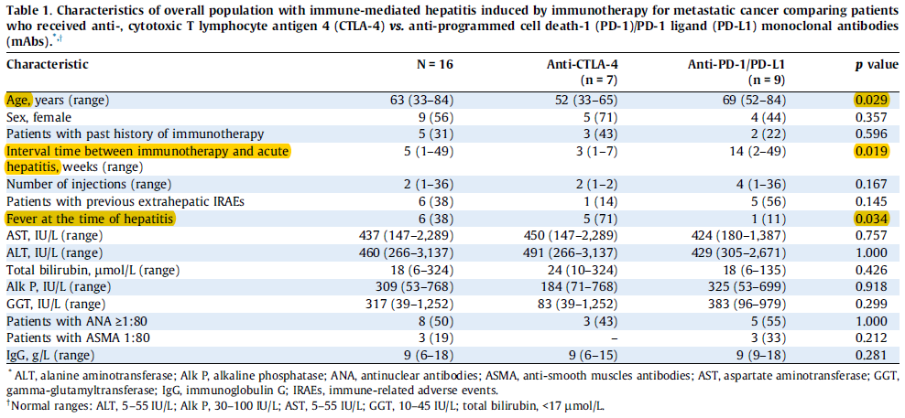
Characteristics of study population (n=16):
Comparison between patients with hepatic IRAEs who received anti-CTLA-4 and patients with hepatic IRAEs who received anti-PD-1/anti-PD-L1
Notes:
A comparison of AST, ALT, GGT, Alk P,
and IgG values did not reveal any statistically significant
difference between patients receiving anti-CTLA-4 vs. anti-PD-
1/PD-L1 mAbs.

Slide 10
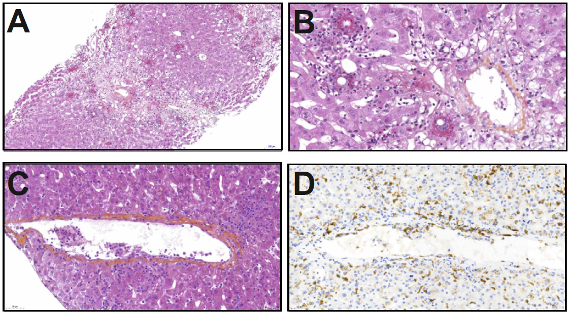
Histological pattern of anti-CTLA-4 hepatitis (n=7)
Granulomatous hepatitis associated with severe lobular necrotic an inflammatory activities (5/7)
Central vein endotheliitis
Sinusoidal inflammatory infiltrates comprising lymphocytes and histocytes. No plasma cells.
Centrilobular confluent necrosis with fibrin ring granulomas
Endotheliitis of a centrolobular vein with perivenular and subendothelial infiltration by lymphocytes and histiocytes and focal disruption of endothelium
Lymphocytes CD8+ cytotoxic
Notes:
Biopsies were performed witin 48-120h of the increase in liver tests
At the time of diagnosis, two patients were already taking corticosteroid therapy for the treatment of acute hepatitis and 2 other patients were taking corticosteroids because of non-hepatic IRAEs.
In all cases, the inflammatory infiltrates mainly comprised activated lymphocytes and histiocytes, with only few or no plasma cells
A Centrilobular confluent necrosis with fibrin ring granulomas
B sinusoidal inflammatory infiltrates comprising lymphocytes and histiocytes, without plasma cells
C Endotheliitis of a centrilobular vein with perivenular and subendothelial infiltration by lymphocytes and histiocytes and focal disruption of endothelium
D lymphocytes CD8+ cytotoxic

Slide 11
Histological pattern of anti-PD-1/PD-L1 hepatitis (n=9)
Lesions of active hepatitis with spotty or confluent necrosis and mild to moderate activity, not associated with granulomatous inflammation
Microgranulomatous clusters, without fibrin deposit (2/9)
Portal fibrosis (5/9) (F3 fibrosis in one patient linked to chronic biliary obstruction because of hilar cholangiocarcinoma)
Immunostaining: CD4/CD8 proportion linked to treatment
Patients treated with anti-CTLA-4: CD8 predominance in portal tracts and in lobules infiltrate
Patients treated with anti-PD-1/PD-L1 mAbs: CD4 and CD8 in equal proportions in portal infiltrates, slight predominance of CD8 in lobular infiltrates.
Lobular lymphocytes
Active hepatitis with mild periportal and moderate lobular activity
Notes:
E Lobular lymphocytes.
F Active hepatitis with mild periportal and moderate lobular activity.
Immunostaining revealed different proportions of CD4 and CD8 lymphocytes between patients who did or did not receive anti-CTLA-4 mAbs.
In patients treated with anti-CTLA-4 mAbs, inflammatory infiltrates in portal tracts, and even more in lobules, were mainly represented by CD8 lymphocytes.
In patients treated with anti-PD-1/PD-L1 mAbs, portal infiltrates comprised CD4 and CD8 lymphocytes in equal proportions, whereas lobular infiltrates showed a slight predominance of CD8 lymphocytes.
FOXP3-positive lymphocytes were rarely detected in liver biopsies except in samples from Patient 2, who received a combined therapy, and no difference was observed between patients treated with anti-CTLA-4 and patients treated with
anti-PD-1/PD-L1 alone. Immunostaining for ERG highlighted alterations of sinusoidal endothelial cells, particularly those in close contact with granulomas in patients treated with anti-CTLA-4 mAbs, but not in patients treated with either anti-PD-
1/PD-L1 mAbs alone.

Slide 12
Management:
Severe histological lesion
Spontaneous improvement in liver tests

Slide 13
Discussion
Predisposing factors: Influence of a previously exposition to immunotherapy
Histological findings : Role of the treatment on the histological pattern
Management and prophylaxis

Slide 14
Discussion
1. Predisposing factors: Influence of a previously exposition to immunotherapy
Pre-treatment with anti-PD-1 as risk factor: enhancement of the immune system ?
Influence of pre-treatment with anti-PD-1 vs anti-CTLA-4: comparison of two cohort studies showing a better tolerance for patients first treated with anti-CTLA-4 (ipilimumab) than anti-PD-1 (nivolimumab)
Greater risk of IRAEs by combined therapy (anti-PD-1 and anti-CTLA-4) vs single therapy ?
Weber JS et al. Lancet Oncol 2016;17:943–955
Zhang X et al. Drug Des Devel Ther 2016;10:3153–3161.
Wolchok JD et al. N Engl J Med 2013;369:122–133.

Slide 15
Discussion
2. Histological findings : Role of the treatment on the histological pattern
Anti-CTLA-4 monotherapy or in combination with anti-PD-1: Granulomatous hepatitis with fibrin deposition and central vein endotheliitis
Anti-PD-1/anti-PD-L1: Lobular, non-granulomatous hepatitis
-> more heterogeneous liver damage, involving lobular and periportal activity
Immune-mediated hepatitis rather than autoimmune-like hepatitis
Precise grading and staging provide crucial elements for the therapeutic decision
Risk of chronicity
Ribas A et al. N Engl J Med 2013;368:1365–1366.

Slide 16
Discussion
3. Management and prophylaxis
CTAE system recommendation for grade 3 hepatitis: corticosteroid 1-2mg or 2-4mg/kg/d
-> Decision to initiate the treatment and the choice of dose based on the presence of jaundice (bilirubin >2.5 mg/dl (42.75 micromole/L)) and/or liver failure (INR ≥1.5) and the severity of histological liver damage (activity grade 3)
-> Consider the addition of a 2° immunosuppression drug for patients not improving with high doses corticosteroids
-> Corticosteroid therapy does not seem to impact tumor response
Re-introduction of immunotherapy following hepatic IRAEs?
-> Prophylaxis: corticosteroid, budenoside and ursodeoxycholic acid, liver-directed topical corticosteroids

Slide 17
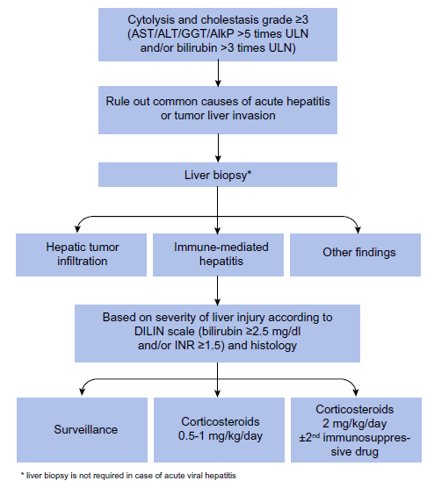
Assessment and Management:

Slide 18
Limitations
Limited number of patients:
Emerging and probably growing problem because of the efficacy of immunotherapy, consequently increasing number of immune related liver injuries
No predisposing factors for hepatic IRAEs identified:
No biomarkers have yet been identified to predict the occurrence of IRAEs in patients receiving checkpoint inhibitors

Slide 19
Conclusion (1)
Acute grade ≥3 hepatitis in only 3.5% of patients who received immunotherapy for metastatic cancer (1-8% in other studies)
DILI remains an exclusion diagnosis -> Always exclude infection, toxic (drugs, alcohol, plants), malignant infiltration (lymphoma), etc.
Liver biopsy: Always indicated to rule out differential diagnosis and to give information on the severity of the liver injury to guide the management (evt. avoid corticosteroids).

Slide 20
Conclusion (2)
Identification of two different histological patterns of immune-mediated hepatitis
Management remains challenging and must be patient-oriented.
Further studies are necessary to elucidate the mechanisms underlying liver toxicities and to identify predictive and prognostic factors.

Slide 21
Thank you for your attention

Slide 22
Points we can discuss
Management: How do we understand the “patient-oriented therapy”? Do we need some more criteria? What about the algorithms?
Possibility to re-challenge patients after a first occurrence of hepatitis IRAEs?
Need of corticosteroid prophylaxis by re-challenging patient after hepatic IRAEs?
Predictive/prognostic factors: how to go on with research? need for cohort study? RCT?
Mechanisms: further on histological studies needed to understand mechanisms underlying liver toxicities of immunotherapy?

