Slide 1
Isocaloric Diets High in Animal or Plant Protein Reduce Liver Fat and Inflammation in Individuals With Type 2 Diabetes.
Markova M, et al. Department of Clinical Nutrition of the German Institute of Human Nutrition Potsdam-Rehbruecke (Nuthetal, Germany)
Gastroenterology. 2017 Feb;152(3):571-585.e8.
Dr Maria Guarino

Slide 2
EASL. J Hepatology 2016

Slide 3
Background
High-protein diets have shown favorable effects on glucose metabolism and insulin sensitivity in people with type 2 diabetes (T2D), and it is unclear which metabolic pathways are involved.
Diets restricted in methionine were shown to prevent the development of insulin resistance and of the metabolic syndrome in animal models by activating the protective FGF21 pathway.
BCAAs were proposed to induce insulin resistance by clogging mitochondrial adenosine triphosphate production.
Plant proteins (PPs) contain much lower levels of methionine and BCAAs than Animal proteins (APs), which was proposed to mediate some advantages of vegetarian diets.

Slide 4
AIM
High-protein interventions in patients with NAFLD are lacking.
In addition, there are no data regarding whether or not the origin of dietary protein plays a role in liver fat accumulation in humans with NAFLD.
The aim of the present study was to compare the effects of
2 isocaloric high-protein diets containing either AP or PP
on liver fat content in subjects with T2D accompanied by NAFLD.

Slide 5
Materials and Methods - 1
Study design: 6-week intervention randomized clinical trial with an open-label, parallel arm study design.
Group matching for age, sex, BMI, glycated hemoglobin A1c, and glucose-lowering drugs.
Both diets were isocaloric and had the same macronutrient composition (30 % protein, 40% carbohydrates, 30% fat). The AP diet was rich in meat and dairy foods, the PP diet consisted mainly of legume protein.
Participants were asked to maintain their physical activity patterns for the duration of the study.

Slide 6
Materials and Methods - 2
Exclusion criteria:
impaired renal, liver, or thyroid function;
glucocorticoid therapy, stroke, or heart attack in the last 6 months, or cancer in the last 2 years;
acute or chronic inflammatory disease, mental disorders and depression, food intolerance, or weight change >3 kg within the previous 3 months.

Slide 7
Materials and Methods - 3
The following procedures were performed at the beginning and the end of the study:
subcutaneous adipose tissue (SAT) samples collection
hyperinsulinemic euglycemic clamp
meal tolerance test
magnetic resonance imaging and magnetic resonance spectroscopy for quantification of abdominal fat depots and intrahepatic lipids, respectively
indirect calorimetry in the fasting state to estimate the resting energy expenditure and the respiratory quotient
fasting blood collections for measuring: routine markers, plasma FFA, insulin, IL-18, monocyte chemotactic protein-1, adiponectin, FGF21, caspase-cleaved keratin 18 fragment by M30-Apoptosense, IL-8, TNF-a, IL-6.

Slide 8
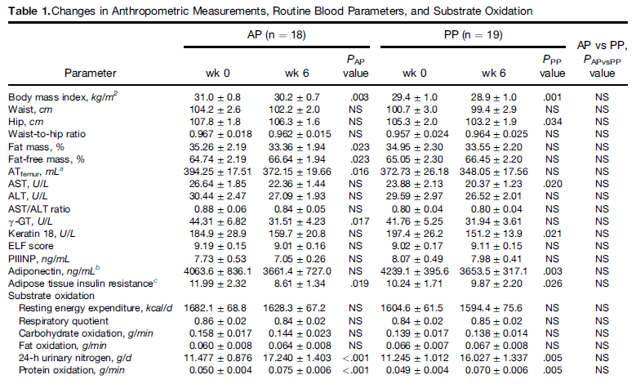
Results
A total of 37 participants concluded the clinical study
(AP group: 6 females, 12 males; PP group: 7 females, 12 males).
Notes:
Despite consumption of an isocaloric diet and the attempt to keep body weight constant by increasing food intake, participants
in both groups showed a moderate but significant reduction of body mass index (AP: 0.8 kg/m2 ± 0.1 kg; PP: 0.5 ± 0.1 kg/m2), which was not significantly different between the groups.
Resting energy expenditure and respiratory quotient did not change during the intervention.
As expected, protein oxidation, calculated from the urinary urea nitrogen excretion, increased significantly in all participants without
differences between groups.
Keratin 18 fragment, a marker of necro-apoptotic processes in liver,29 declined significantly in all participants (P ¼ .002), and significantly in the PP but not AP subgroup.

Slide 9
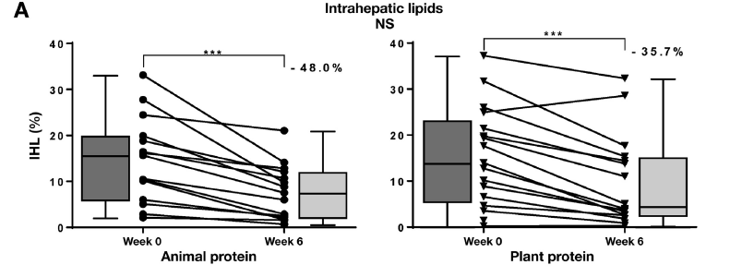
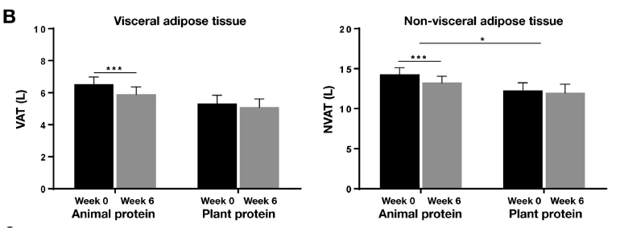
Lipid contents
P < 0.001
P < 0.001
P < 0.05
P < 0.001
P < 0.001
Notes:
Reduction of IHL by 36-48%
The origin of protein did not play a major role

Slide 10
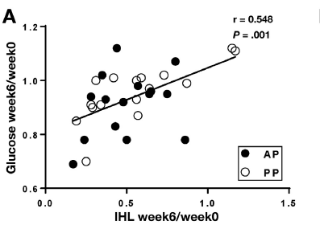
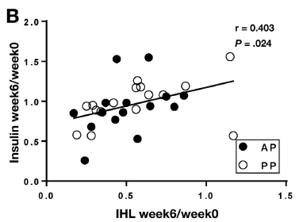
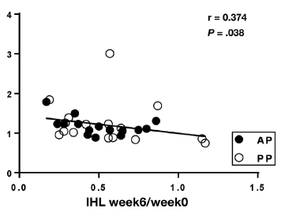
Insulin-sensitivity
Relative reduction of IHLs correlates with relative changes in metabolic parameters.
Insulin-sensitivity
Notes:
Improvement of whole body insulin sensitivity and adipose tissue insulin resistance

Slide 11
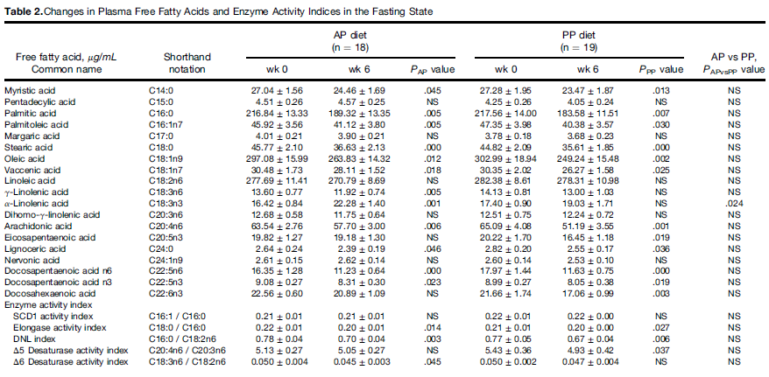
Free Fatty Acids Blood Levels
Notes:
To assess changes of lipid metabolism in adipose tissue upon the high-protein diet and its possible contribution to the IHL reduction, FFA levels before and after the intervention were measured.
A significant decrease of all saturated FFA.
With regard to polyunsaturated fatty acids, levels of linoleic acid (C18:2n6) did not change, while arachidonic acid (C20:4n6) decreased significantly in both groups.
the index of de novo lipogenesis (16:0/18:2n6) decreased significantly in both groups
these results show a very specific pattern of changes regarding preserved u-6 FFA, which were associated with reduced diabetes risk

Slide 12
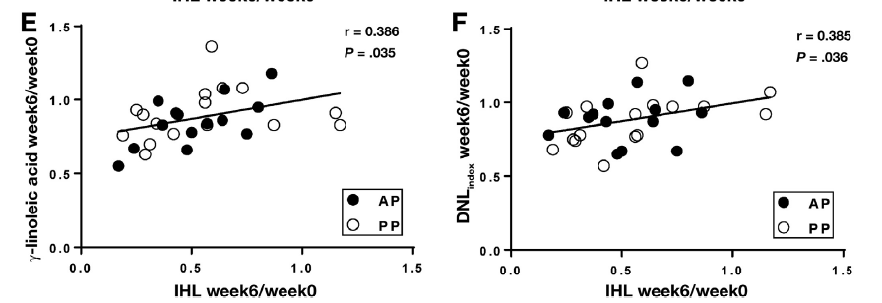
The levels of γ-linoleic acid and the reduction of the de novo lipogenesis index correlated with the change in IHLs.

Slide 13
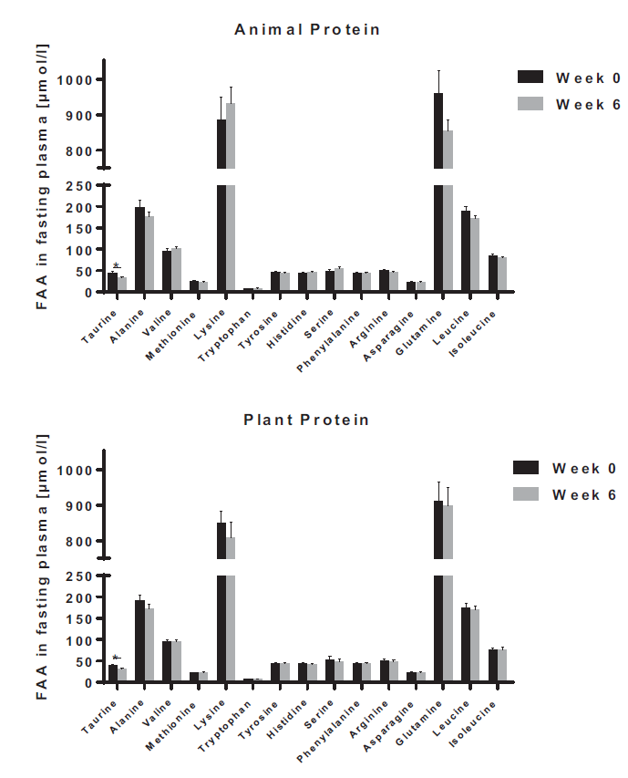
Free Amino Acid Blood Levels
Analysis showed no significant changes in the levels of 14 amino acids.
Only taurine decreased in both groups.

Slide 14
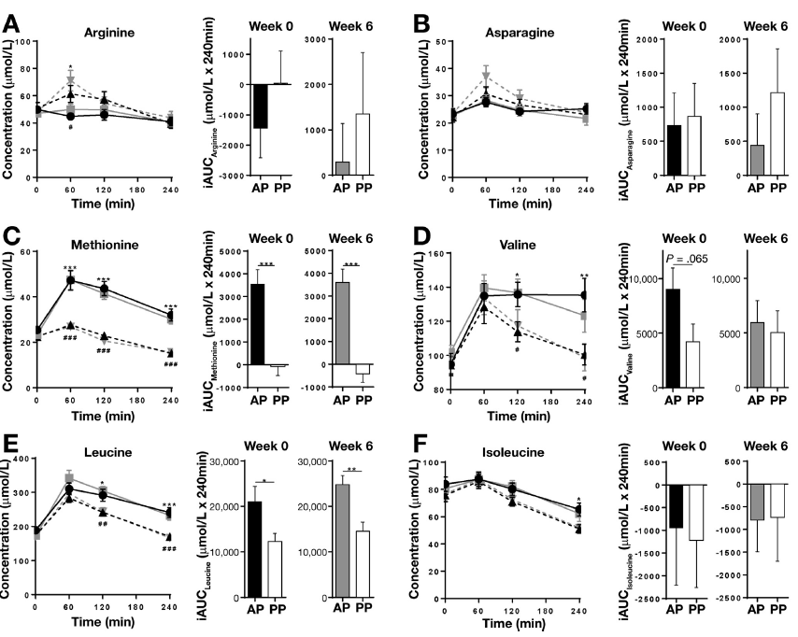
Differences in postprandial free amino acid levels after PP and AP meals.
Notes:
The PP group showed larger increases of asparagine and arginine (Figure 3A and B),
while the AP meal resulted in much larger increases in methionine and BCAA (Figure 3CF), corresponding with
the amino acid content of the different protein types.

Slide 15
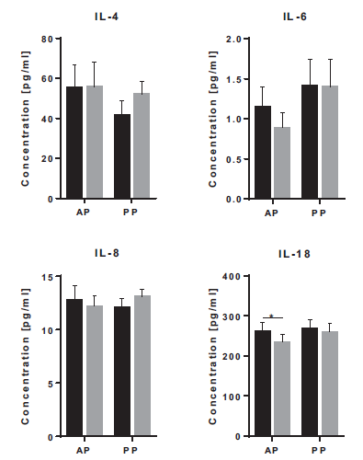
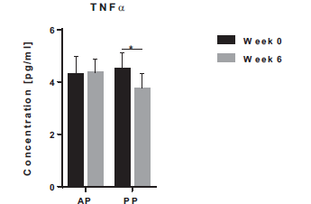
Inflammatory Markers
Notes:
a modest reduction of inflammatory markers with the high-protein diets.

Slide 16
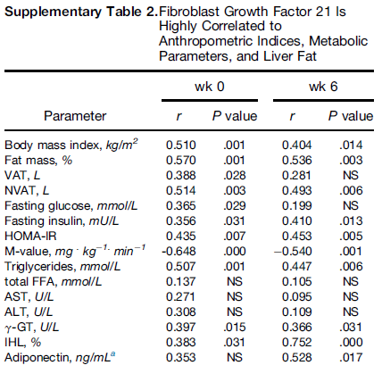
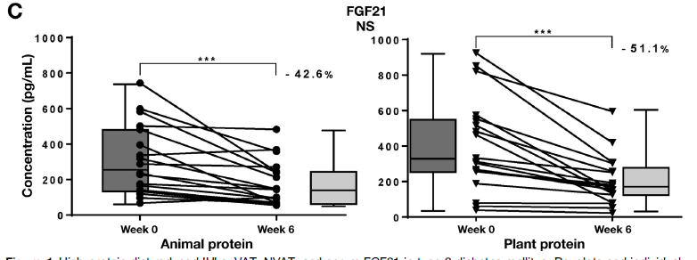
FGF-21
FGF21 correlates with anthropometric and metabolic indices in humans, including liver fat.
FGF21 levels were reduced in both groups. The reduction might reflect an improvement of hepatic ER stress and improved mitochondrial function due to the reduction of liver fat.
P < 0.001
P < 0.001
Notes:
FGF21 acts as a nutrient sensor to regulate macronutruient intake.
The reduction might reflect an improvement of hepatic ER stress and improved mitochondrial function due to the reduction of liver fat.

Slide 17
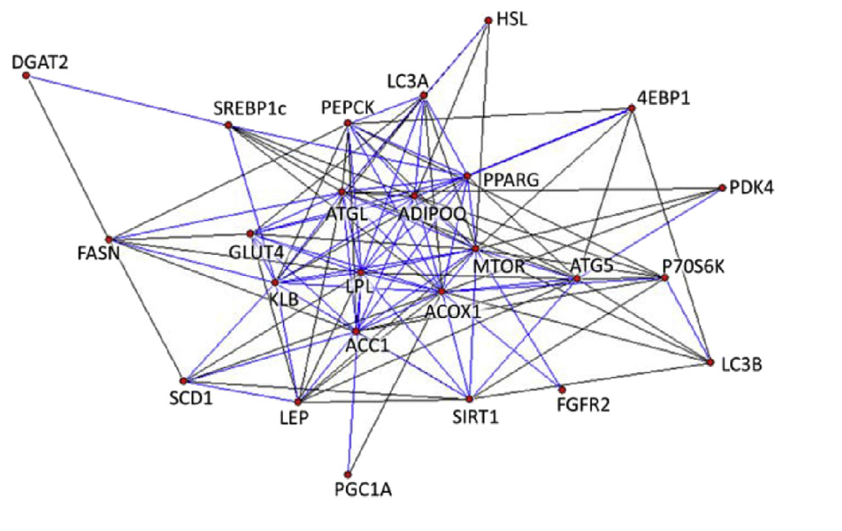
Gene Expression and Protein Modification in Adipose Tissue
The changes of gene expression showed a critical role of the FGF21 pathway with the major lipid metabolic enzymes.
Remarkably there was no evidence for an activation of the MTOR pathway in adipose tissue.
Bioinformatics approach
Notes:
Correlation network of changes in gene expression. The color of the edges represents the quantity of the correlation coefficients (blue: 0.75>s0.5; black: 0.5>s0.3). All correlation coefficients were positive and highly significant.
used a bioinformatics approach to understand the interaction of pathways involved and calculated correlation networks.

Slide 18
Conclusions
This study demonstrated the effective reduction of IHLs in patients with T2D and NAFLD consuming isocaloric high-protein diets.
The origin of protein does not play a major role. Both AP and PP diets show a beneficial effect associated with decreases of fasting FFA and FGF21, as well as increase of insulin sensitivity.
Molecular analysis of the signaling pathways in subcutaneous adipose tissue revealed no activation of mTOR pathway upon the AP or PP diet.
Nevertheless, larger and longer dietary intervention studies are needed to show the durability of the responses and eventual adverse effects of the diets.
Notes:
The origin of protein did not play a major role
Improvement of whole body insulin sensitivity and adipose tissue insulin resistance

