Slide 1
Acute-on-Chronic Liver Failure
Portal Hypertension Session 04.10.2023 – Giulio Roncolato

Slide 2
Liver Cirrhosis
Injury
Necrosis and regeneration of hepatocytes
Fibrosis and capillarization of the hepatic sinusoid
Decreased hepatic parenchyma
Disturbance of blood flow and portosystemic shunt
Portal hypertension
Liver insufficency
Notes:
Currently, both terms “cACLD” and “compensated cirrhosis” are acceptable, but not interchangeable.

Slide 3
Compensated advanced chronic liver disease (cACLD) vs Compensated Cirrhosis
Cirrhosis -> Defined with use of invasive test -> Biopsy -> Gold Standard
METAVIR F4 und Ishak F5–F6
Necro-Inflammation (Activity)
Regression
Malignant Transformation
cACLD -> Defined with use of non-invasive tests (NITs)
FS values between 10 and 15 kPa are suggestive of cACLD
FS values >15 kPa are highly suggestive of cACLD.
Notes:
Currently, both terms “cACLD” and “compensated cirrhosis” are acceptable, but not interchangeable.

Slide 4
Clinically significant portal hypertension (CSPH)
Invasive Test -> hepatic venous pressure gradient (HVPG)
Values >5 mmHg indicate sinusoidal portal hypertension
In patients with viral- and alcohol-related cirrhosis an HVPG >−10 mmHg -> CSPH
Non invasive Test -> FS
In patients with virus- and/or alcohol-related cACLD and non-obese (BMI <30 kg/m2) NASH-related cACLD, a LSM value by TE of >− 25 kPa is sufficient to rule in CSPH
LSM values between 20-25 kPa and platelet count <150x109/L or LSM values between 15-20 kPa and platelet count <110x109/L have a CSPH risk of at least 60%

Slide 5
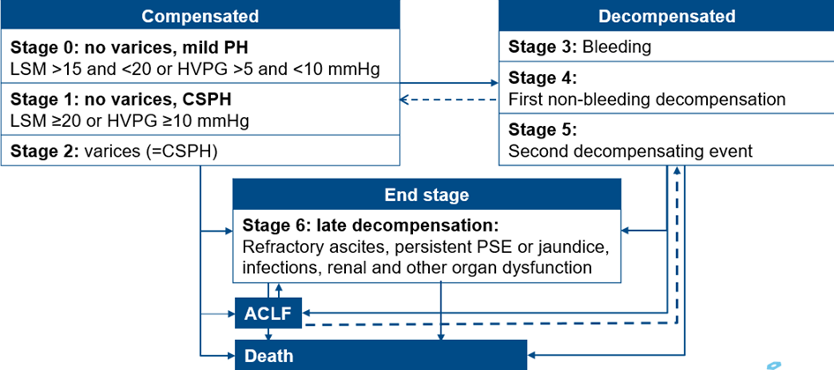
Decompensated Cirrhosis
“Decompensation is marked by the development of overt clinical signs”
Clinical Practice Guidelines for the management of patients with decompensated cirrhosis, EASL 2018

Slide 6
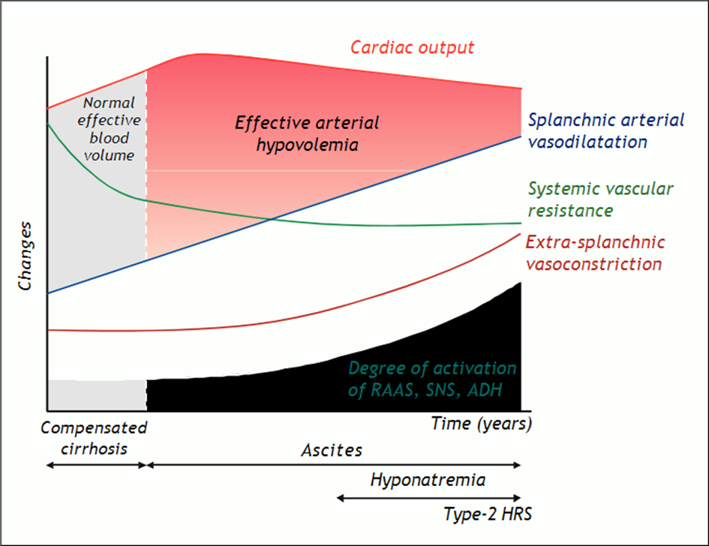
Portal Hypertension
Variceal hemorrhage
Portal hypertensive gastropathy
Ascites/SBP
Hepatic hydrothorax
Hepatorenal syndrome
Hepatopulmonary syndrome
Portopulmonary hypertension
Cirrhotic cardiomyopathy
Relationship Between Systemic Hemodynamics, Renal Dysfunction, and Fluid Retention in Cirrhosis. Clinical Liver Disease, 2013

Slide 7
Other complications
Hepatic encephalopathy
Jaundice
Hepatocellular carcinoma
Portal vein thrombosis
Bacterial infections
Notes:
Due to Liver Insuff

Slide 8
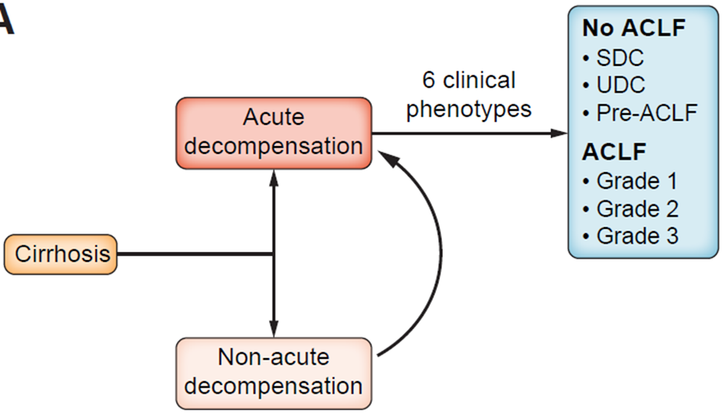
EASL-CLIF-C definitions
Patients with cirrhosis who are non-electively admitted to the hospital for recent onset
Ascites
gastrointestinal haemorrhage
newly developed hepatic encephalopathy
or any combination of these disorders
Notes:
According EASL-CLIF-C definition of ACLF (Chronic Liver Failure (CLIF) Consortium)

Slide 9
EASL-CLIF-C definitions
refers to the occurrence of a progressive liver related complication that does not lead to hospitalisation
Notes:
EASL-CLIF-C definition of ACLF (Chronic Liver Failure (CLIF) Consortium)

Slide 10
EASL-CLIF-C definitions
stable decompensated cirrhosis (SDC): patients in this group were discharged and not readmitted during the 3-month follow-up
unstable decompensated cirrhosis (UDC): developed liver-related complications, but not ACLF, and were readmitted during the 3-month follow-up
pre-ACLF: developed ACLF during the 3-month follow-up
Notes:
EASL-CLIF-C definition of ACLF (Chronic Liver Failure (CLIF) Consortium)

Slide 11
EASL-CLIF-C definitions
the functional failure of one or more of the six major organ systems (i.e., liver, kidney, brain, coagulation, circulation, and respiration)
and systemic inflammation, that may have been induced by acute precipitants
Intrahepatic insults
extrahepatic insults
or both
Notes:
EASL-CLIF-C definition of ACLF (Chronic Liver Failure (CLIF) Consortium)

Slide 12
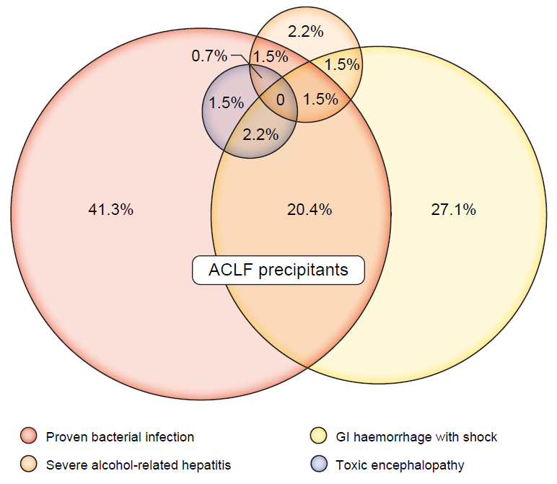
Physiopathology - Precipitant of ACLF
Acute intrahepatic or extrahepatic insult
Patients with two or more precipitants have a higher risk of death at 90 days
The PREDICT study uncovers three clinical courses of
acutely decompensated cirrhosis that have distinct
Pathophysiology, JHEP 2020
Notes:
In China, the main precipitants of ACLF are flares of HBV infection and bacterial infections
Not only the organ failure, as we will see later, but also the n of precipitants is related to worse outcome
Another important finding of the PREDICT study was the imbalance in the prevalence of precipitants of ACLF (Fig. 4).
The two commonest single precipitants were severe proven bacterial infection and alcohol-related hepatitis.
Bacterial (and viral, CAVE HEV) infections (mostly SBP and pneumonia)
Severe alcohol-related hepatitis
Gastrointestinal haemorrhage with shock
Acute encephalopathy caused by drugs

Slide 13
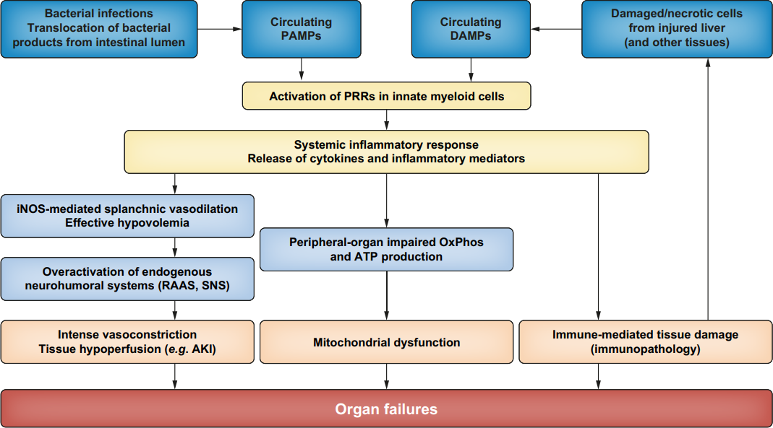
Physiopathology
Acute-on-chronic liver failure: Definitions, pathophysiology and principles of treatment JHEP 2020
Notes:
DAMPs, damage-associated molecular patterns; PAMPs, pathogen-associated molecular patterns; PRRs, pattern-recognition
receptors; iNOS, inducible nitric oxide synthase; OxPhos, oxidative phosphorylation; RAAS, renin-angiotensin-aldosterone system; SNS, sympathetic nervous
system.

Slide 14
Pathogen-associated molecular patterns (PAMPs) and damage-associated molecular patterns (DAMPs)
Pathogen-associated molecular patterns (PAMPs) expressed by microbes
mostly related to translocation of bacterial products from the intestinal lumen -> unrelated to ongoing bacterial infections -> ACLF without any identified precipitating disorder
Damage-associated molecular patterns (DAMPs) released by dying or damaged host cells from various compartments (liver injury)
Recognised by dedicated pattern-recognition receptors (PRRs, e.g. TLRs), expressed in innate myeloid cells (i.e., monocytes and neutrophils)
PRR engagement drives intracellular signalling cascades, leading to the transcription and synthesis of inflammatory mediators
Notes:
intestinal bacterial overgrowth, increased permeability of the intestinal mucosa, and impaired function of the intestinal innate immune system

Slide 15
Tissue hypoperfusion
Inducible nitric oxide (NO) synthase in splanchnic arteriolar walls
Splanchnic vasodilation
Decreases effective arterial blood volume
Homeostatic overactivation of the endogenous neurohumoral vasoconstrictor system
Intense vasoconstriction, particularly in the renal circulation

Slide 16
Immune-mediated tissue damage
ACLF is commonly associated with blood leukocytosis
Activated immune cells migrate into tissues and cause immunopathology
TNF-α and NF-κB-dependent signaling pathways
impaired left ventricular contractility
pulmonary dysfunction
macrophage accumulation in lung microvasculature
hepatocyte apoptosis.
ACLF-associated AKI
not only involve tissue hypoperfusion
but also capillary leukocyte infiltration, vascular microthrombosis, and cell apoptosis.

Slide 17
Immune-mediated tissue damage
ACLF is commonly associated with blood leukocytosis
Activated immune cells migrate into tissues and cause immunopathology
TNF-α and NF-κB-dependent signaling pathways
impaired left ventricular contractility
pulmonary dysfunction
macrophage accumulation in lung microvasculature
hepatocyte apoptosis.
ACLF-associated AKI
not only involve tissue hypoperfusion
but also capillary leukocyte infiltration, vascular microthrombosis, and cell apoptosis.
Inflammatory damage to tissues and cells leads to the release DAMPs
Vicious cycle sustains and exacerbates inflammatory responses

Slide 18
Mitochondrial dysfunction
peripheral organs may have a marked decrease in mitochondrial fatty acid b-oxidation in peripheral organs
decreased oxidative phosphorylation and ATP production.
defective energy production may play a role in the development of OFs in ACLF
Notes:
High-throughput blood metabolomics performed in a large
cohort of patients with acutely decompensated cirrhosis
(CANONIC cohort),

Slide 19
Immunosuppression
Secondary infections are common complications of ACLF
Indicate that patients with ACLF are immunosuppressed.
“humoral” and immune-cell alterations
Among patients with ACLF who are free of infections at presentation, higher blood levels of immunosuppressive molecules (interleukin-10, tryptophan metabolite quinolinate) -> predictors of secondary infections.
Defective responses to PAMPs have been shown in macrophages
higher frequency of CD14+monocytes expressing the receptor tyrosine kinase MerTK and CD14+CD15-HLA-DR-myeloid-derived suppressor
neutrophils have a defect in both the production of antimicrobial superoxide anion and bactericidal activity.

Slide 20
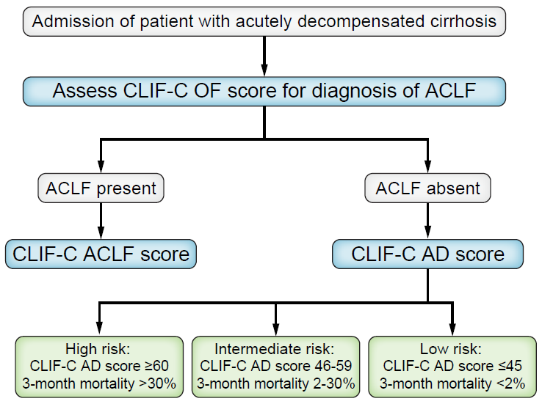
Flowchart

Slide 21
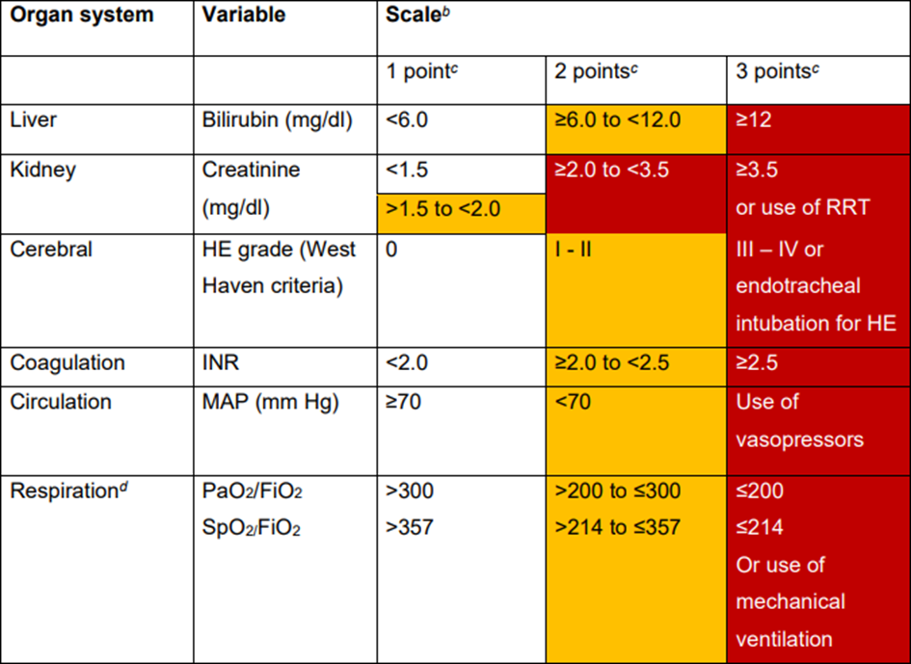
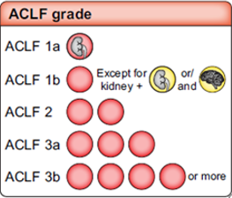
CLIF-C ACLF OF (organ failure) score
Score from 6 to 18
Mortality at 28 days
Notes:
First Step ma altra rappresentazione e lo score che ti da (da 6 a 18) va usato nello score successivo-> CLIF-C ACLF (OF) organ failure score
(Acute-on-Chronic Liver Failure)

Slide 22
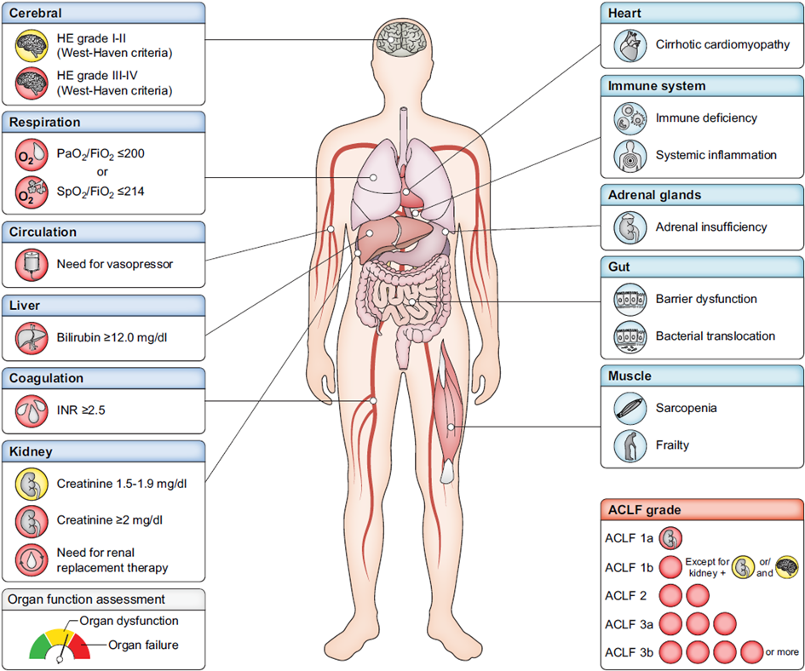
Notes:
First Step
On the right, in light blue, are shown additional organ systems whose function is altered in patients with ACLF.

Slide 23
Mortality – CANONIC cohort
No ACLF: 4.5%
Grade 1: 20%
Grade 2: 30%
Grade 3: 80%
Notes:
Grade 1: 20%
Grade 2: 30%
Grade 3: 80%

Slide 24
Flowchart

Slide 25
CLIF-C ACLF score
Combines
the CLIF-C OF score (6-18) together with
age
white cell count
Score ranging from 0-100
28-day and 90-day mortality
10 x [0.33 x CLIF-C OF score + 0.04 x Age + 0.63 x Ln (white-cell count) – 2])
calculator is available at www.efclif.com
Notes:
Second step

Slide 26
Flowchart

Slide 27
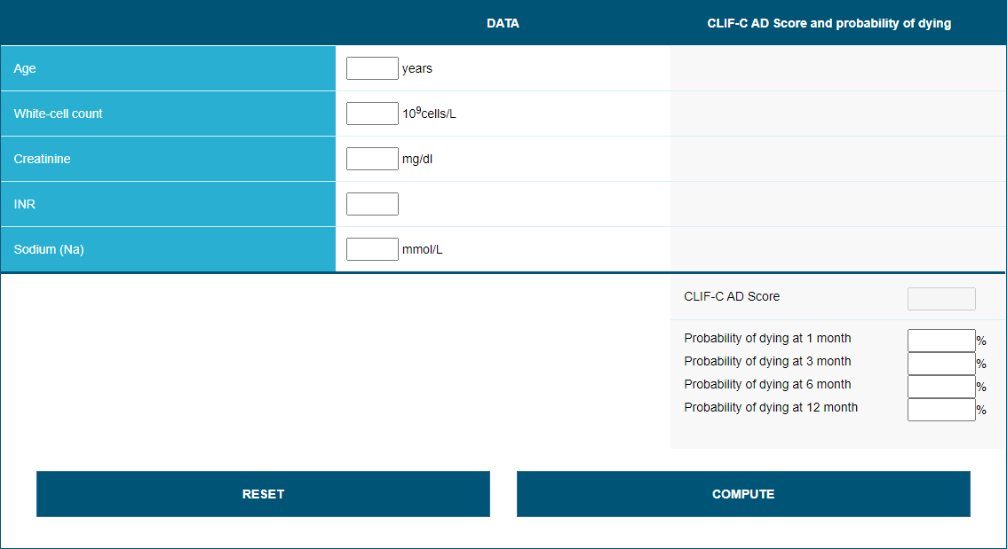
CLIF-C AD (acute decompensation) score
Mortality (90-180-365-day)
Prediction Developement ACLF
https://www.efclif.com/scientific-activity/score-calculators/clif-c-ad
Notes:
Second step
Decompensation without ACLF mortality rate
at day 28 after presentation is only 5% but it increases to
12.6% at 3 months,
18.3% at 6 months, and
27.6% at 1 year
The CLIF-C AD score was derived from analysis of clinical data from the patients included in the CANONIC study who did not have ACLF at presentation
CLIF-C AD score, model for end-stage liver disease (MELD) score or MELD-Na score can be used to define risk of development of ACLF
In an internal validation cohort of 500 patients, the CLIF-C AD score performed better than the MELD, MELD-Na and Child-Pugh scores in predicting 90-day, 180-day and 365-day mortality.

Slide 28
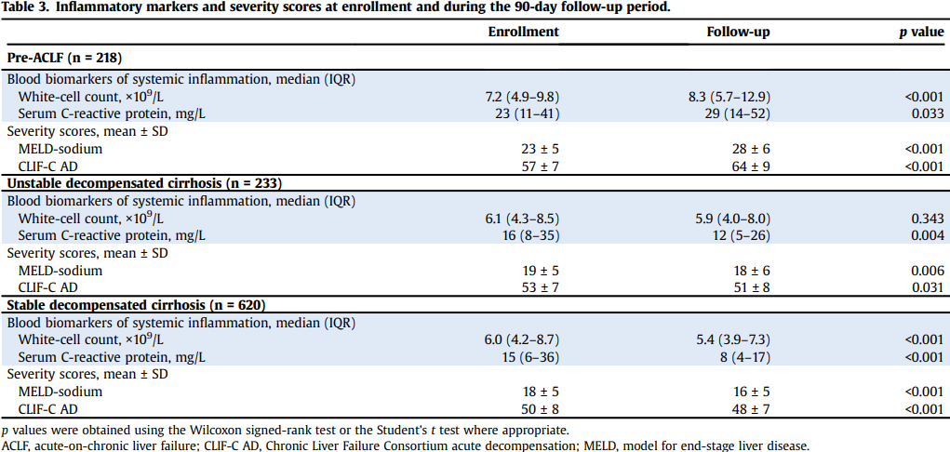
Prediction Developement ACLF
The PREDICT study uncovers three clinical courses of
acutely decompensated cirrhosis that have distinct
Pathophysiology, JHEP 2020

Slide 29
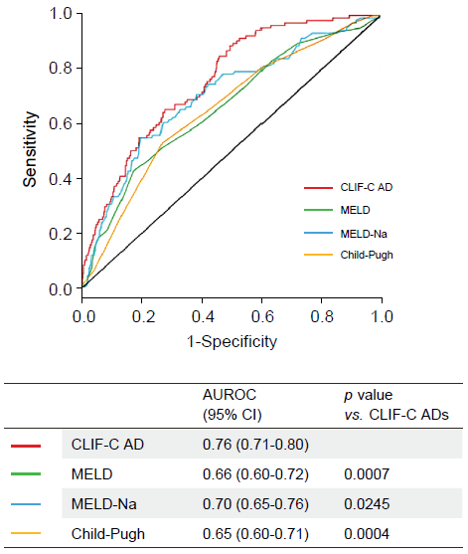
Notes:
In patients with ACLF, the CLIF-C ACLF score provides
more accurate information than the MELD score, MELD-Na
score, and Child-Pugh score in predicting the risk of 28-day
and 90-day mortality
ACLF grades (based on the
number of organ failures) enable categorisation of patients
with a wide range of 28-day and 3-month mortality risks. In
order to develop a prognostic score specifically for patients
with ACLF, the CLIF-C ACLF score was developed using data
from the CANONIC study;2
The C indices of the CLIF-C ACLF score for 28-day and 90-day mortality (0.76 and 0.73, respectively) were significantly better than those of the MELD score (0.69 and 0.66, respectively; p <0.001 each), MELD-Na score (0.68, 0.66; p <0.001 each) and Child-Pugh score (0.67 and 0.66, respectively; p <0.001)
In patients with acutely decompensated cirrhosis and no
ACLF, the CLIF-C AD score provides more accurate
prognostic information than the MELD score, MELD-Na
score, and the Child-Pugh score in predicting the risk of
90-day, 180-day and 365-day mortality (LoE 2,
consensus).
CLIF-C AD score, MELD score and MELD-Na score have
similar ability to predict the occurrence of ACLF and all
perform better than the Child-Pugh score

Slide 30
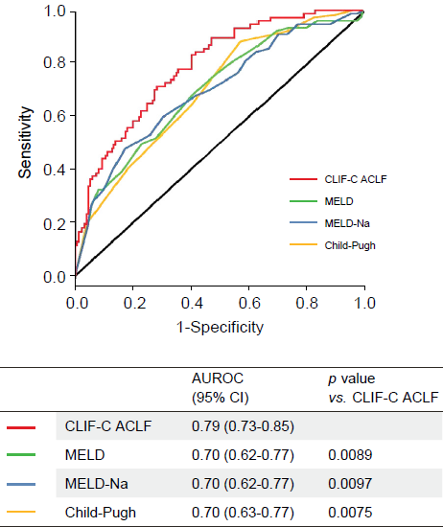
Notes:
In patients with ACLF, the CLIF-C ACLF score provides
more accurate information than the MELD score, MELD-Na
score, and Child-Pugh score in predicting the risk of 28-day
and 90-day mortality
ACLF grades (based on the
number of organ failures) enable categorisation of patients
with a wide range of 28-day and 3-month mortality risks. In
order to develop a prognostic score specifically for patients
with ACLF, the CLIF-C ACLF score was developed using data
from the CANONIC study;2
The C indices of the CLIF-C ACLF score for 28-day and 90-day mortality (0.76 and 0.73, respectively) were significantly better than those of the MELD score (0.69 and 0.66, respectively; p <0.001 each), MELD-Na score (0.68, 0.66; p <0.001 each) and Child-Pugh score (0.67 and 0.66, respectively; p <0.001)
In patients with acutely decompensated cirrhosis and no
ACLF, the CLIF-C AD score provides more accurate
prognostic information than the MELD score, MELD-Na
score, and the Child-Pugh score in predicting the risk of
90-day, 180-day and 365-day mortality (LoE 2,
consensus).
CLIF-C AD score, MELD score and MELD-Na score have
similar ability to predict the occurrence of ACLF and all
perform better than the Child-Pugh score

Slide 31
Drugs
proton-pump inhibitors
antibiotics (piperacillin/tazobactam, meropenem, ciprofloxacin, norfloxacin, metronidazole) and antifungals (fluconazole)
are known to cause acute encephalopathy in cirrhosis at standard recommended dosages because of increased serum concentrations, which are caused by decreased renal clearance, increased volume distribution, or increased passage through the blood-brain barrier.

Slide 32
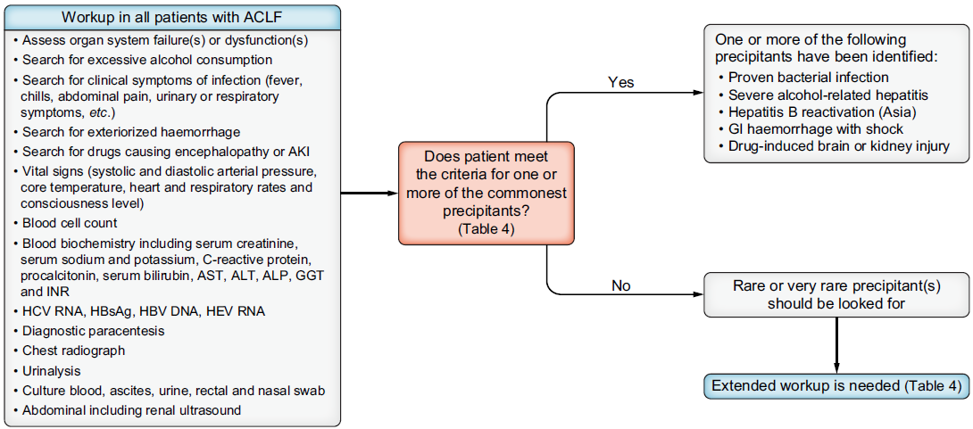
Work Up
fails to identify the existence of a precipitant in 35% of patients with ACLF
Notes:
proven bacterial infection
alcohol-related hepatitis
gastrointestinal haemorrhage with haemodynamic instability
flare of HBV infection
hepatitis E virus infection (underestimated)
recent use of a drug known to cause cerebral failure
and recent use of a drug known to cause kidney failure (underestimated)

Slide 33
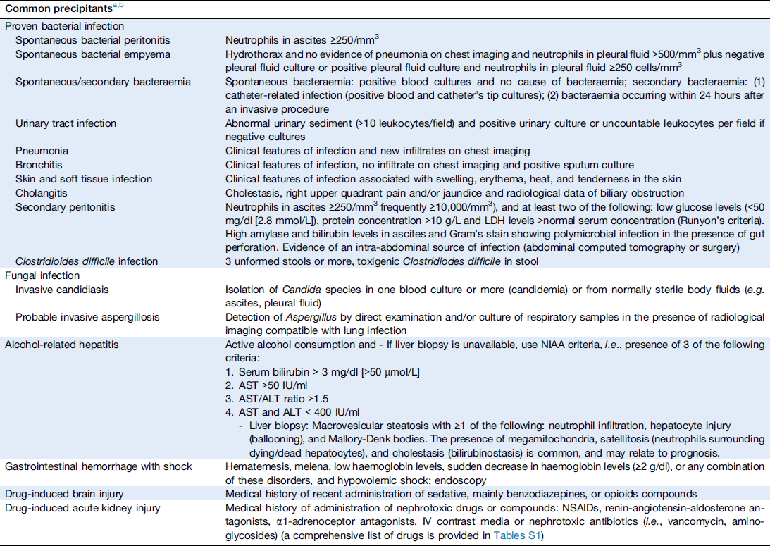

Slide 34
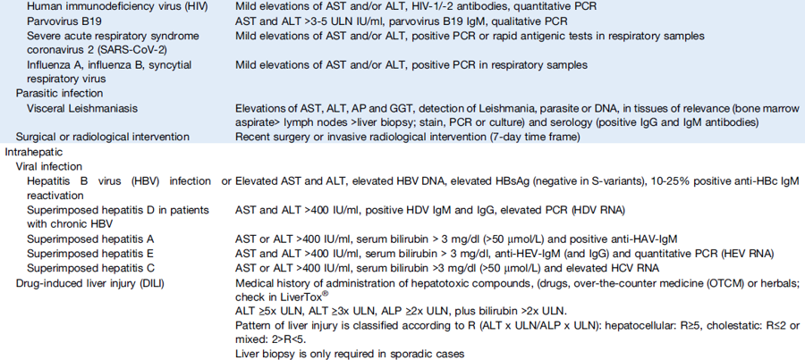

Slide 35
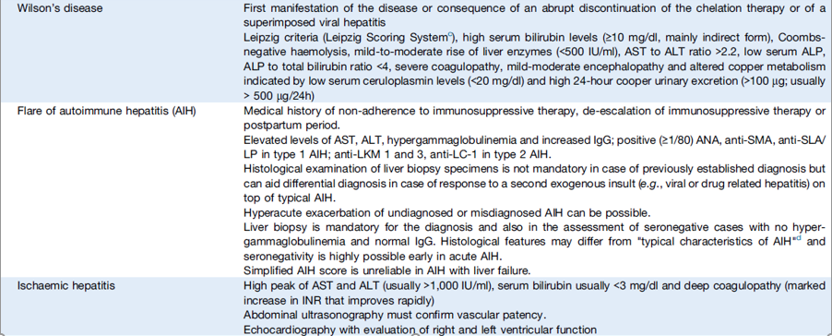
Rare precipitants

Slide 36
HBV Reactivation
NAs should be started immediately in patients with HBV-related ACLF
high resistance barrier (tenofovir and entecavir) improved 3-month survival compared to placebo (57% vs. 15%).
Liver transplantation if MELD score >30 or ACLF-2 or -3
Poor outcome in the absence of early virologic response (<2-log reduction at week 2) and lack of clinical improvement
3-month mortality rates without liver transplantation of around 50–55%.
Notes:
Nucleos(t)ide analogues
and a randomised-controlled trial reported no survival differences between entecavir-, tenofovir disoproxil fumarate-, tenofoviralafenamide- treated patients.

Slide 37
Steroids in Autoimmune Hepatitis
Evidence for the role of corticosteroids in patients with AIH and ACLF is very limited -> evaluated on a case-by-case
Histological assessment is warranted to verify AIH with active inflammation
Should be avoided in case of uncontrolled infection
Close surveillance for infection and strict monitoring of the efficacy
Notes:
When considering treatment with corticosteroids, histological assessment is warranted to verify
AIH with active inflammation.77,78 Histology is also important since a significant proportion of patients with AIH presenting with ACLF (AIH-ACLF) can be seronegative.
Two studies. Ref 81 82
Ninetyday
survival was higher among patients who received corticosteroid
treatment than among those who were not
receiving corticosteroids and did not have baseline sepsis
(75% vs. 48%, respectively; p = 0.02). The median length of
ICU stay in the corticosteroid group was also significantly
lower (1.5 vs. 4 days, p <0.0001). Incidence of newly developed
sepsis was similar in both groups (p = 0.32). However,
in this study, a large proportion of patients (66%) were not
eligible for corticosteroid therapy at baseline due to active infection
high frequency of infections
(41.3%) was reported among patients receiving corticosteroids
despite administration of prophylactic antibiotics.79
Both studies found that a high MELD score (>27 and >24,
respectively) was predictive of treatment failure, although a
Child-Pugh score >11 had superior predictive ability.82 These
results potentially allow for early stratification of patients.
Cautious follow-up changes in different parameters, such as
MELD, MELD-Na, UK model for end-stage liver
disease scores, bilirubin or INR during high-dose
corticosteroid treatment might identify responders who will
not need liver transplant. Improvement in one of these parameters
within 4-7 days of corticosteroid therapy was
associated with higher rates of response to corticosteroids in
various studies of patients with acute severe AIH.83–88
Accordingly, expert opinion suggests if no improvement in
bilirubin or MELD-Na score is observed after 7 days of
corticosteroid therapy in patients with in acute severe hepatitis,
continuing the therapy might be futile, and patients
should be assessed for liver transplantation due to high risk
of progressing to ALF.89

Slide 38
Steroids in Autoimmune Hepatitis
Higher survival among patients without baseline sepsis (75% vs. 48%, p = 0.02)
Shorter ICU stay (1.5 vs. 4 days, p <0.0001)
Similar incidence of newly developed sepsis (p = 0.32)
high MELD score (>27 and >24, respectively) and Child-Pugh score >11 was predictive of treatment failure
Determinants of outcomes in autoimmune hepatitis presenting as acute on chronic liver failure without extrahepatic organ dysfunction upon treatment with steroids. J Clin Exp Hepatol 2021
Flare of autoimmune hepatitis causing acute on chronic liver failure: diagnosis and response to corticosteroid therapy. Hepatology 2019

Slide 39
Alcohol
With increasing severity of ACLF, corticosteroid responsiveness is progressively reduced whilst the risk of infection increases
Corticosteroids are not recommended in patients with severe alcohol-related hepatitis and ACLF-3, nor in patients with uncontrolled bacterial infection
If corticosteroids are administered to patients with severe alcohol-related hepatitis and ACLF, close surveillance for infection should be performed
Notes:
In a single-centre cohort study, the prevalence of ACLF-2 or -3
in patients with biopsy-proven severe alcohol-related hepatitis
was 32%.88 The rates of response to corticosteroids were 42.6%
for patients with ACLF-2 and 8.3% for those with ACLF-3
compared to 76.6% and 52.2% for patients without ACLF and
those with ACLF-1 respectively.
In a sub-analysis of the randomised placebo-controlled
STOPAH trial, a Lille response was observed in 37.5% of patients
with severe ACLF (i.e., ACLF-2 or ACLF-3) receiving
corticosteroids compared to 33% of those receiving placebo(a
non-significant difference).90

Slide 40
Alcohol
Rates of response to corticosteroids
76.6% for patients without ACLF
52.2% for patients with ACLF-1
42.6% for patients with ACLF-2
8.3% for those with ACLF-3
Lille response was observed in 37.5% of patients with severe ACLF (i.e., ACLF-2 or ACLF-3) receiving corticosteroids compared to 33% of those receiving placebo
The prognostic value of acute-on-chronic liver failure during the course of severe alcoholic hepatitis. J Hepatol 2018
Prevalent acute-on-chronic liver failure and response to corticosteroids
in alcoholic hepatitis. J Hepatol 2018

Slide 41
Variceal bleeding
Variceal haemorrhage in patients with ACLF is associated with a very high probability of rebleeding
Both pre-emptive and rescue TIPS should be considered for patients with ACLF and variceal haemorrhage who do not have a contraindication for TIPS
In patients with ACLF, the presence of hepatic encephalopathy should not be considered an absolute contraindication to TIPS
Notes:
ACLF
almost doubles the risk of rebleeding, providing an easy
identification criterion for patients with rebleeding risk
The Baveno Consensus conferences
have recommended the use of pre-emptive TIPS placed within
24-72 hours in patients with Child-Pugh class B (>7) cirrhosis
and active bleeding at endoscopy despite being on vasoactive
drugs, and in patients with Child-Pugh class C (<14 points)
cirrhosis,102,103 since it improves outcomes
This condition frequently meets the criteria of ACLF
Therefore, and considering the marked impact of preemptive
TIPS on rebleeding and most importantly short-term
mortality, this therapeutic tool should be considered in the
management of patients with ACLF and AVH, even in patients
with bilirubin higher than 5 mg/dl.98,99
The consequence would
be to transfer the affected patients to hospitals with access to
TIPS, thereby potentially reducing their mortality rate by 75%.98

Slide 42
Variceal bleeding
ACLF almost doubles the risk of rebleeding
Pre-emptive and rescue TIPS should be considered
HE is not a contraindication
Baveno VII -> pre-emptive TIPS (24-72 hours)
Child-Pugh class B (>7) and active bleeding at endoscopy despite being on vasoactive drugs
Child-Pugh class C (<14 points)
This condition frequently meets the criteria of ACLF
Rebleeding and mortality risk are increased by ACLF but reduced by pre-emptive TIPS. J Hepatol 2020
Determinants of mortality in patients with cirrhosis and uncontrolled variceal bleeding. J Hepatol 2021
Notes:
transfer the affected patients to hospitals with access to TIPS, thereby potentially reducing their mortality rate by 75%.98

Slide 43
Bacterial and fungal infections (Trigger or Precipitant)
Trigger ACLF (mostly SBP and pneumonia)
MDRO and XDRO cause 50% ACLF
Risk factors: ascites, HE, poor liver function, a high MELD score, failed empirical antibiotic treatment. High fatality rate
development of ACLF-2 or ACLF-3 due to bacterial infection -> worse 90-day transplant-free survival (45% vs. 70%, respectively)
Clinical features and evolution of bacterial infection-related acute-onchronic liver failure. J Hepatol 2021
Bacterial and fungal infections in acute-on-chronic liver failure: prevalence, characteristics and impact on prognosis. Gut 2017
Notes:
Bacterial infections, especially with MDR and XDR organisms, are associated with the highest risk of ACLF development, accounting for almost half of ACLF cases globally. The risk is particularly high in those with ascites, hepatic encephalopathy, poor liver function, a high MELD score, and in whom empirical antibiotic treatment has failed.
The common infections that can trigger ACLF include SBP and pneumonia. Patients who develop ACLF following a bacterial infection have high case fatality rates and are frequently unable to clear the infection 116

Slide 44
Bacterial and fungal infections
Precipitate ACLF
Bacterial infections present
in 44% of patients admitted for decompensated cirrhosis
in 1/3 of those admitted to the hospital with ACLF
In 1/3 of those admitted to the hospital with ACLF will develop bacterial infections within 4 weeks
1/3 of those admitted to the hospital with ACLF won’t develop bacterial infections
Bacterial and fungal infections in acute-on-chronic liver failure: prevalence, characteristics and impact on prognosis. Gut 2017
Notes:
In fact, bacterial infections may
precipitate ACLF or develop during the course of ACLF. Bacterial
infections can be detected in up to 44% of patients
admitted to the hospital for acutely decompensated cirrhosis
who then develop ACLF,3 and in one-third of those admitted to
the hospital with a diagnosis of ACLF.117
Among the remaining
patients with ACLF, approximately half develop bacterial infections
within a follow-up period of 4 weeks.

Slide 45
Bacterial and fungal infections
Suspected infection -> early administration of broadspectrum empirical antibiotic treatment
tailored according to the local epidemiology
presence of risk factors for antibiotic resistance
reduction in mortality rate
any delay is associated with an increase in mortality, particularly in patients with septic shock
Cooperative Antimicrobial Therapy of Septic Shock (CATSS) Database Research Group. Antimicrobial therapeutic determinants of outcomes from septic shock among patients with cirrhosis. Hepatology 2012
Notes:
The clinical course, the
development of ACLF-2 or ACLF-3 at the final assessment
and the probability of 90-day transplant-free survival are all
worse in patients with ACLF and bacterial infection, either at
diagnosis or during follow-up, than in those without a bacterial
infection (45% vs. 70%, respectively).
Timeliness and adequacy of initial antibiotic
strategies are associated with lower critical care requirements,
better evolution of the syndrome in infectiontriggered
ACLF and lower 28- and 90-day mortality.117

Slide 46
Bacterial and fungal infections
Early de-escalation of empirical antibiotics within a 24-to-72-hour time frame is suggested
De-escalation should be based on rapid microbiological tests and MDRO colonisation data
Time to pathogen identification
up to 5 days if only classical microbiological test
1 to 6 hours rapid microbiological techniques (MALDI-TOF MS [matrix-assisted laser desorption ionization-time of flight mass spectrometry] and multiplex PCR
Optimisation of antibiotic dosing through prolonged infusions and reduction of the duration of total antibiotic therapy (up to 7 days for most infections)
Notes:
Time to pathogen identification and associated sensitivities in clinical
samples can take up to 5 days if only classical microbiological
tests are used, resulting in prolonged exposure to
broad-spectrum antibiotics. This delay affects the ability for
physicians to promptly de-escalate to targeted anti-infective
therapy and apply judicious antibiotic stewardship. The use
of rapid microbiological techniques reduces this delay. Culture-
and non-culture-based rapid techniques (MALDI-TOF
MS [matrix-assisted laser desorption ionization-time of flight
mass spectrometry] and multiplex PCR among others) can
be used to identify the pathogen(s) and define its antimicrobial
susceptibility within 1 to 6 hours, thus facilitating
rapid de-escalation.1
Optimisation of antibiotic dosing through prolonged infusions
and reduction of the duration of total antibiotic therapy
(up to 7 days for most infections)

Slide 47
Invasive fungal infections
Develop in 1-5% of patients with decompensated cirrhosis
1% to 47% in ACLF
Candidiasis/candidemia (70-90%) aspergillosis (10-20%)
Risk factors
Cirrhosis associated immunodeficiency
Broad-spectrum antibiotic exposure
Multifocal colonization
Indwelling catheters
Total parenteral nutrition
Diabetes mellitus
Prolonged ICU stay
Renal replacement therapy
Severe alcohol-related hepatitis (aspergillosis)
prolonged steroid therapy (aspergillosis)
Management of bacterial and fungal infections in cirrhosis: the MDRO challenge. J Hepatol 2021
Bacterial and fungal infections in acute-on-chronic liver failure: prevalence, characteristics and impact on prognosis. Gut 2017
Notes:
In a prospective investigation that
included 98 patients with biopsy-proven severe alcoholrelated
hepatitis, the incidence of invasive aspergillosis was
16%. In this study, risk factors for acquisition of invasive
aspergillosis were ICU admission and a baseline MELD score
>−24 points.128
Though much more infrequent than bacterial infections, the
impact of invasive fungal infections on prognosis is huge, with
28-day case fatality rates of 45-60% for invasive candidiasis
and even higher for invasive aspergillosis.113 Moreover, invasive
fungal infections are a major contraindication for liver
transplantation and therefore a frequent cause of delisting.
Current Surviving Sepsis guidelines recommend the empirical
administration of antifungal therapy (mainly echinocandins)
in patients with septic shock at risk of fungal infections.129
Patients with ACLF and prolonged ICU stay fall into this population,
especially if they are listed or in the process of being
listed for liver transplantation. This empirical strategy should be
followed by a rapid de-escalation if fungi are not identified. In
that sense, two negative determinations of 1,3-b-D-glucan (an
antigen present in the cell wall of many fungi including Candida)
in blood samples can be used to safely discontinue antifungals.
113,130 The prognostic impact of prompt initiation of
empirical antifungal therapy in this setting deserves
further investigation.

Slide 48
Invasive fungal infections
28-day case fatality rates of 45-60% for invasive candidiasis and even higher for invasive aspergillosis.
major contraindication for liver transplantation and therefore a frequent cause of delisting.
Empirical antifungal therapy (echinocandins) could be indicated in ACLF developing a nosocomial septic shock who have additional risk factors for fungal infection
rapid de-escalation if fungi are not identified -> two negative determinations of 1,3-b-D-glucan
Executive summary: surviving sepsis campaign: international guidelines for the management of sepsis and septic shock 2021. Crit Care Med 2021
Notes:
This empirical strategy should be followed by a rapid de-escalation if fungi are not identified. In
that sense, two negative determinations of 1,3-b-D-glucan (an
antigen present in the cell wall of many fungi including Candida)
in blood samples can be used to safely discontinue antifungals.
113,130 The prognostic impact of prompt initiation of
empirical antifungal therapy in this setting deserves
further investigation.

Slide 49
Nutritional support, sarcopenia, and frailty

Slide 50
Non-selective beta-blockers (NSBBs)
The decision to continue using NSBBs is based on close monitoring of the mean arterial pressure and renal function
In patients who recover from an episode of ACLF, NSBBs should be initiated cautiously, with close monitoring of blood pressure. Dose increases should be guided by the mean arterial pressure; below a threshold of 65 mmHg, beneficial effects are limited
Patients on NSBBs had less severe ACLF on admission and their 28-day mortality was significantly lower.
Amelioration of systemic inflammation in advanced chronic liver disease upon beta-blocker therapy translates into improved clinical outcomes.
Gut 2021
Notes:
The first study is based on analysis of 349
patients with cirrhosis and ACLF who were among patients of
the CANONIC cohort. Of these 349 patients, 155 were already
being treated with NSBBs before admission whereas the
remaining 194 were not receiving the drug.169 The group on
NSBBs had less severe ACLF on admission and their 28-day
mortality was significantly lower.

Slide 51
Liver transplantation
An early assessment for liver transplantation should be proposed for all patients with severe ACLF (ACLF-2 or -3) -> clear survival
benefit in patients with severe ACLF, but the limits of patient suitability are unknown
Liver transplantation of patients with severe ACLF is associated with a substantial increase in resource utilization

Slide 52
Liver transplantation
An early assessment for liver transplantation should be proposed for all patients with severe ACLF (ACLF-2 or -3)
Deceased-donor liver transplantation survival compared to no transplantation in ACLF (2-)3
95% vs. 23%, respectively at 28 days
90.5 vs. 12.5%, respectively at 90 days
Liver transplantation in the most severely ill cirrhotic patients: a multicenter study in acute-on-chronic liver failure grade 3. J Hepatol 2017
Clinical course of acute-on-chronic liver failure syndrome and effects on prognosis. Hepatology 2015

Slide 53
Liver transplantation
All transplanted patients experienced complications (hepatic vascular and biliary tract complications)
81% developed post-transplantation-acquired bacterial infections, 35% viral infections, 15% fungal infections.
more frequent acute cellular rejection
ICU and total hospital lengths of stay are increased
more likely to be transferred to a rehabilitation
Liver transplantation in the most severely ill cirrhotic patients: a multicenter study in acute-on-chronic liver failure grade 3. J Hepatol 2017
Patients with severe acute-on-chronic liver failure are disadvantaged by model for end-stage liver disease-based organ allocation policy. Aliment Pharmacol Ther 2020
Notes:
based on a retrospective study from 10 North American centres, the presence of
• portal vein thrombosis in patients with ACLF-3 was associated with a significant 1-year posttransplant survival reduction (57% vs. 92%).

Slide 54
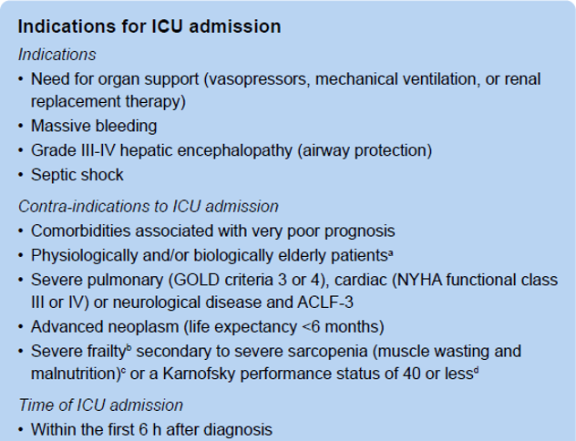
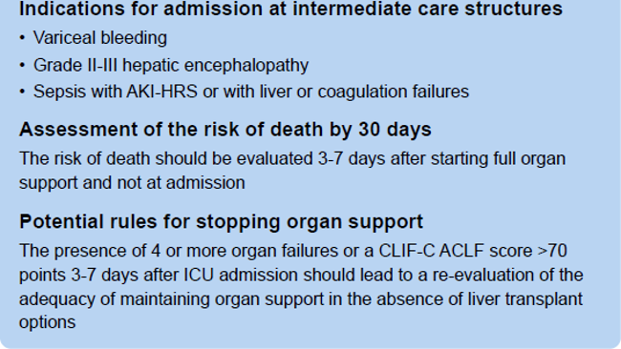
Admission ICU
Notes:
Table S8 summarize!!!!!!!!
Patients with ACLF requiring close monitoring or organ support (vasopressors, mechanical ventilation, or renal replacement therapy)
Criteria for deciding admission to the ICU for patients with ACLF are similar to those applied in the population of patients without cirrhosis

Slide 55
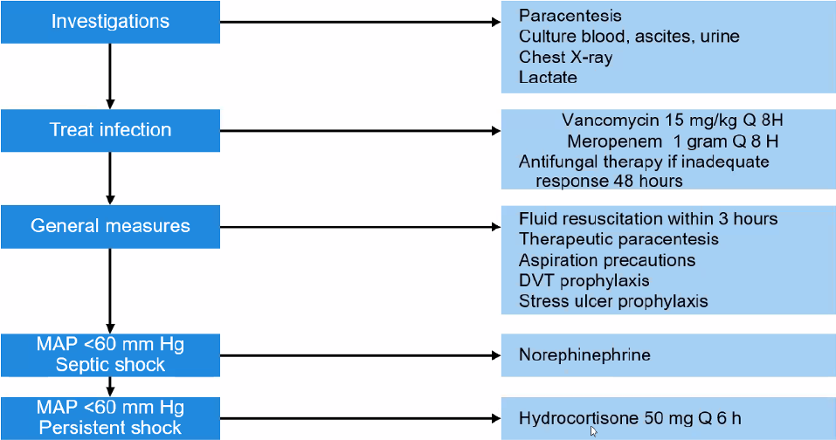
Management
Notes:
Slide Hepa meeting

Slide 56
Admission ICU
Prognosis in patients with ACLF should be determined after 3-7 days of full organ support
one fifth of patients ACLF-3 resolve the syndrome
The presence of >-4 organ failures or a CLIF-C ACLF score >70 points in individuals with no option for salvage liver transplantation -> consider withdrawal of organ support
CANONIC Study Investigators of the EASL–CLIF Consortium
Notes:
The CANONIC study showed that
Patients with ACLF 2-3 at day 3-7 who were transplanted early had a 6-month probability of survival of 80.9% compared to 10% in non-transplanted patients. 64

Slide 57
Futility
Not all patients with ACLF-3 are suitable candidates for liver transplantation
Inadequate 1-year post-transplant survival (43%-46%) for patients with ACLF-3 or critically ill patients requiring multiple organ support
3-7 days of full organ support
Orthotopic liver transplantation in critically ill cirrhotic patients with multi-organ failure: a single-center experience. Transpl Proc 2011
Impact of acute-on-chronic liver failure on 90-day mortality following a first liver transplantation. Liver Int 2017
Risk factors for posttransplantation mortality in recipients with grade 3 acute-on-chronic liver failure: analysis of a North American consortium. Liver Transpl 2022

Slide 58
Futility
Criteria for futility (each of them was associated with 1-year post-LT survival of <84%)
active gastrointestinal bleeding
control of sepsis for less than 24 hours
haemodynamic instability requiring doses of norepinephrine >50 lg/min
lung failure defined as a PaO2/FiO2 ratio <150
Liver transplantation in the most severely ill cirrhotic patients: a multicenter study in acute-on-chronic liver failure grade 3. J Hepatol 2017

Slide 59
Futility
Pre-transplant MDRO infections
Arterial lactate at transplantation >4.4 mmol/L and
Need for renal replacement therapy at transplant
Liver transplantation for patients with acute-on-chronic liver failure (ACLF) in Europe: results of the ELITA/EF-CLIF collaborative study (ECLIS). J Hepatol 2021
Notes:
A large retrospective European study
were independently associated with post-transplant mortality

Slide 60
Futility
age >−53 years
pre-transplant arterial lactate >−4 mmol/L
mechanical ventilation with PaO2/FiO2 ratio <−200
pre-transplant leukocyte count <−10 G/L
Transplantation for ACLF-3 model (TAM)
>2 was associated with a 1-year posttransplant survival rate of only 8.3%
Liver transplantation for critically ill cirrhotic patients: stratifying utility based on pretransplant factors. Am J Transplant 2020
Notes:
In another retrospective multicentre study, Artzner et al.
factors were independently associated with post-transplant mortality
They developed a simple model, called transplantation for ACLF-3 model (TAM), where the presence of each risk factor was associated with a score of 1 and the final TAM score was the sum. A TAM score >2 was associated with a 1-year posttransplant survival rate of only 8.3%. A TAM score >2 was validated in an independent cohort, wherein it was associated with a 1-year post-transplant survival rate of 10%.

Slide 61
Futility
severe frailty (defined by a clinical frailty scale >−7)
ongoing sepsis except for urinary tract infections
previous infection with pan-drug resistant bacteria
a respiratory failure with PaO2/FiO2 ratio <150
a circulatory failure requiring a dose of norepinephrine >1 mcg/kg/min
arterial lactate >9 mmol/L
worsening clinical course
When is a critically ill cirrhotic patient too sick to transplant? Development of consensus criteria by a multidisciplinary panel of 35 international experts. Transplantation 2021
Notes:
Weiss E, Saner F, Asrani SK, Biancofiore G, Blasi A, Lerut J, et al. When is a
critically ill cirrhotic patient too sick to transplant? Development of
consensus criteria by a multidisciplinary panel of 35 international experts.
Transplantation 2021;561–8.
In 2021, 35 experts tried to reach a consensus to define futility or inappropriateness of liver transplantation for critically ill patients with cirrhosis. The majority of experts stated that some risk factors could be used to define limits of transplantation, including

Slide 62
Thank you for the attention
Insel Gruppe AG, Kommunikation und Marketing, Freiburgstrasse 18, CH-3010 Bern

