Slide 1
JOURNAL CLUB
Bern – December 6th, 2017
Dr. Rosangela Piccinni

Slide 2
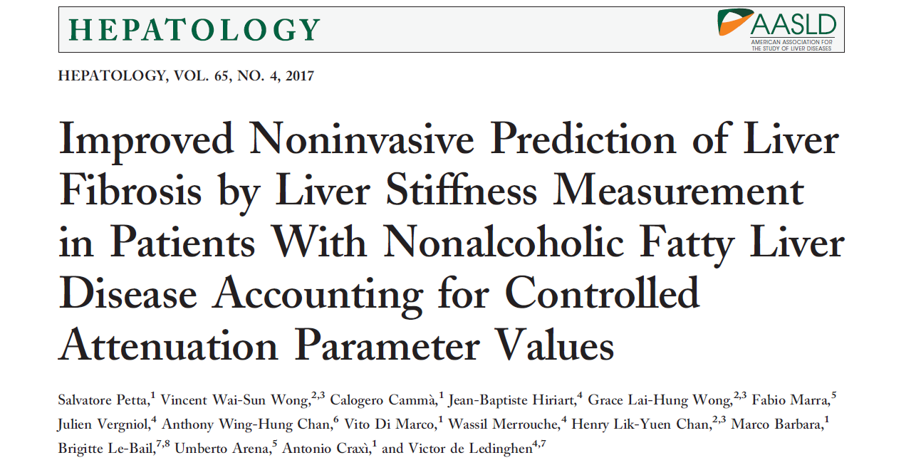

Slide 3
Background
Why steatosis has become a relevant diagnosis :
→NAFLD per sé has become the most frequent cause for hepatologic evaluation: NASH was recentely identified as an important cause of cirrhosis and HCC;
→steatosis/NAFLD is an important co-factor of progression in all CLD.

Slide 4
Background-2
One of the main issue to verify the prognosis of NAFLD patients is the evaluation of liver fibrosis severity
Liver stiffness measurement by transient elastography is a noninvasive tool that can replace liver biopsy

Slide 5
Background-3
Liver stiffness measurement→sufficiently accurate to predict fibrosis stage in NAFLD patients
BUT
its diagnostic performance is affected by obesity and severity of steatosis (increasing the rates of false positive results)
Wong et al, Hepatology 2010
Petta et al, Hepatology 2015

Slide 6
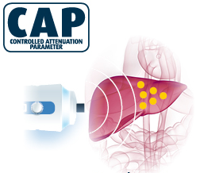
Background-4
A new test for fatty liver: controlled attenuation parameter (CAP)
New non invasive parameter able to provide quantitative and numerical data regarding liver fat content through the quantification of attenuation of ultrasound waves
Berzigotti, J Hepatology 2014
CAP quantifies US attenuation in the liver at the central frequency of the probe.
CAP is numerically expressed in dB/m (100 to 400 dB/m)

Slide 7
Aim of the study
They wanted to determine whether prediction of liver fibrosis by LSM in NAFLD patients is affected by CAP values

Slide 8
Patients and methods
Consecutive patients from 4 prospective cohorts (3 European centers, 1 Asian)
Patients with biopsy-proven NAFLD with reliable LSM and CAP
EXCLUSION CRITERIA:
advanced cirrhosis;
HCC;
other causes of liver disease;
HIV;
Immunosuppressive drugs and/or steatosis-inducing drugs
Active intravenous drug addiction or use of cannabis

Slide 9
Patients and methods-2
LIVER STIFFNESS MEASUREMENT
LSM and CAP were assessed on the same day as liver biopsy
All the LSM were classified into 3 categories:
- very reliable: IQR/M<=0.10
-reliable: 0.10<IQR/M<=0.30
-poorly reliable: IQR/M>0.30

Slide 10
Patients and methods-3
HISTOLOGICAL ASSESSMENT
A minimum 15-mm-long-biopsy specimen
or
At least 10 complete portal tracts
Steatosis→assessed as the percentage of hepatocytes containing fat droplets
Kleiner classification→staging fibrosis
NASH= steatosis+lobular inflammation+ ballooning

Slide 11
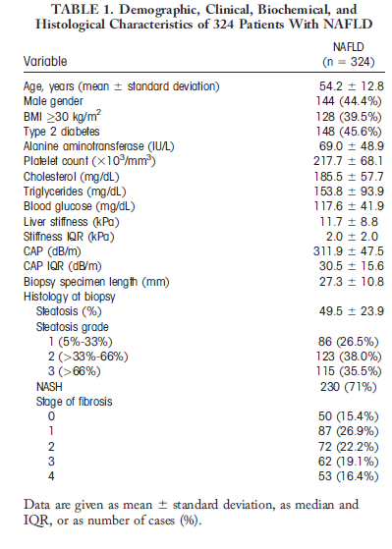
Results - Patients

Slide 12
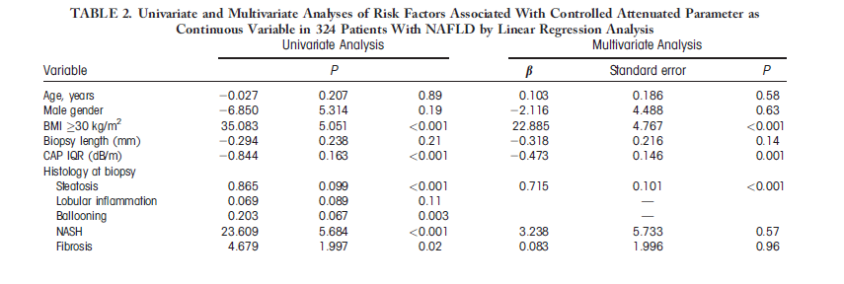
Results – factors associated with CAP
Higher CAP values were significantly associated with CAP IQR, BMI and steatosis

Slide 13
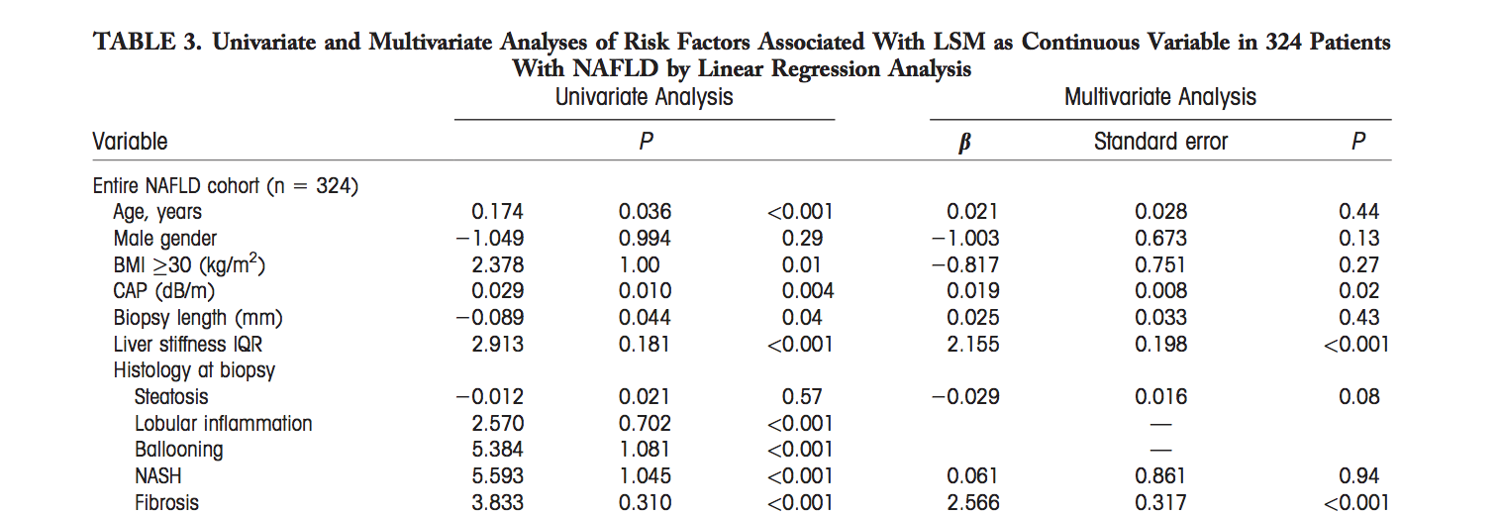
Results – factors associated with LSM
Entire cohort:
LSM independently linked to higher CAP values, higher LSM IQR values and fibrosis

Slide 14
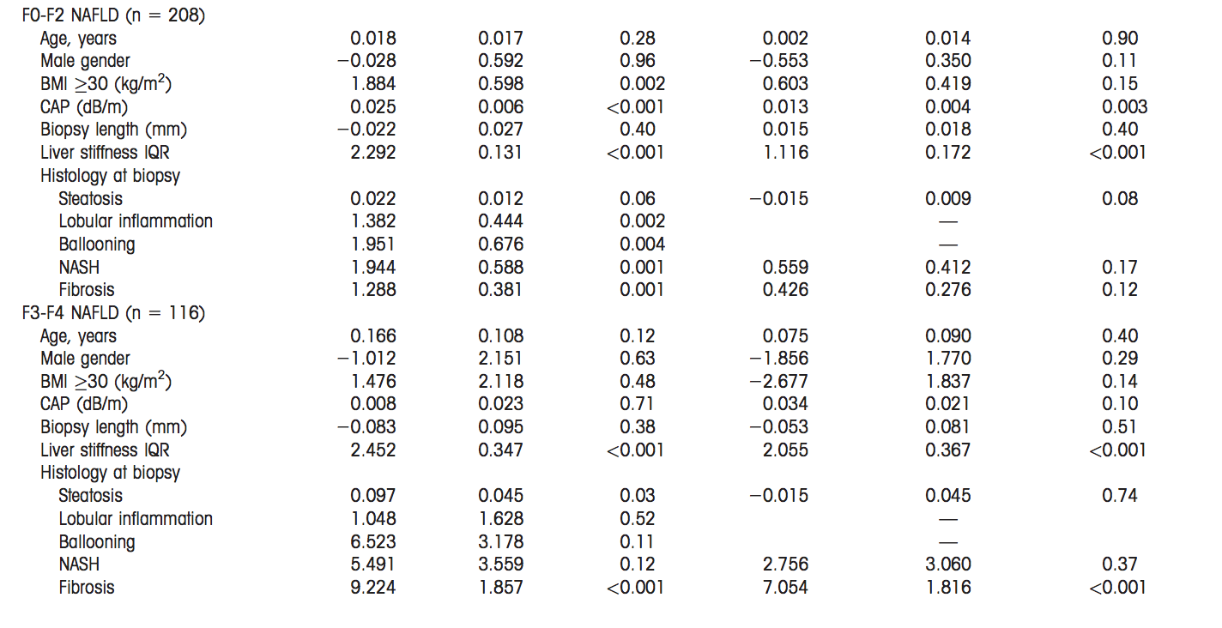
Results – factors associated with LSM
The independent association between LSM and CAP is confirmed in F0-F2 fibrosis but not in F3-F4

Slide 15
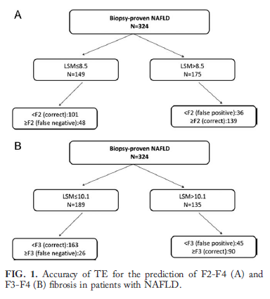
Results – Impact of CAP on LSM values and
on accuracy of TE for staging fibrosis
8.5 kPa: F2-F4 (AUC 0.808, Se 74.3%, Sp 73.7%)
10.1 kPa: F3-F4 (AUC 0.861, Se 77.6%, Sp 78.4%)

Slide 16
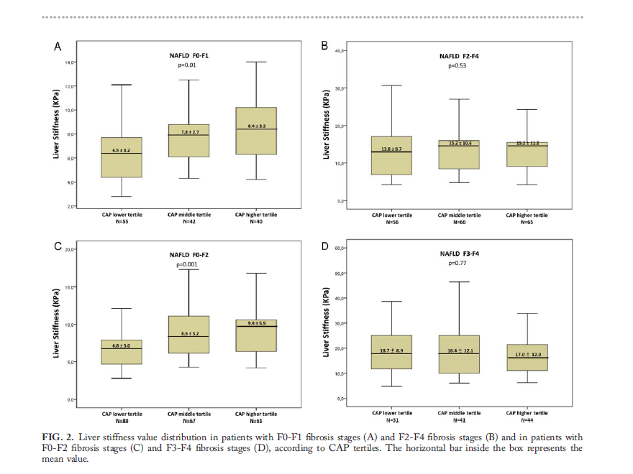
Results – Impact of CAP on LSM values
When patients were considered at each fibrosis stage, for lower grades of fibrosis only, LSM values progressively increased from the lower to the middle and further to the higher CAP tertiles

Slide 17
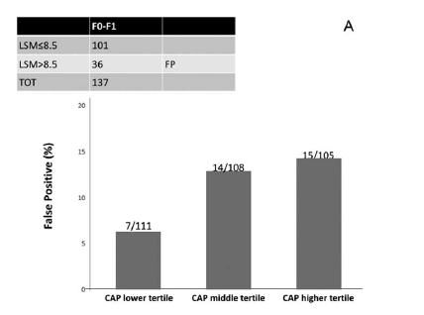
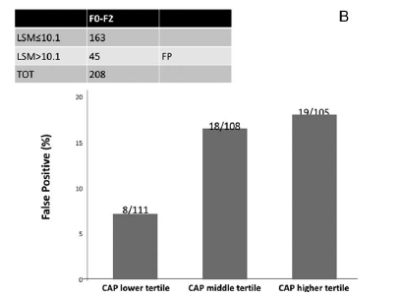
Results – Impact of CAP on LSM values and
on accuracy of TE for staging fibrosis
Rate of false-positive LSM results for the diagnosis of F2-F4 fibrosis increased from the lower CAP tertile to the higher tertiles
Similar differences in false positive LSM results for the diagnosis of F3-F4 fibrosis were observed

Slide 18
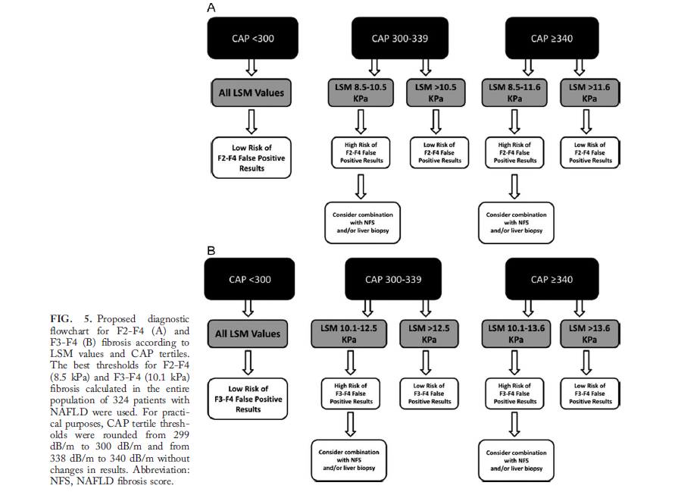
Results – Impact of CAP on LSM values and
on accuracy of TE for staging fibrosis
A diagnostic flowchart for the correct interpretation of LSM values according to CAP values was designed for the diagnosis of F2-F4 and F3-F4 fibrosis

Slide 19
Discussion
CAP is independently linked to increased LSM values, especially in patients with lower stages of fibrosis
Higher rates of false positive LSM in patients in the higher CAP tertiles
Importance of a correct interpretation of LSM values according to CAP

Slide 20
Discussion -2
8.5 kPa and 10.1 kPa are the best cutoffs for discriminating F2-F4 and F3-F4 fibrosis, respectively

Slide 21
Limitations
Interobserver concordance of LSM and CAP examinations as well as of liver histological readings were not assessed;
Analysis of LSM was carried out using a conventional M probe only
Study cohort population: NAFLD subject referred to tertiary center
Lack of follow up

Slide 22
Conclusion
LSM in NAFLD may lead to overstimation of fibrosis in patients with lower stages of disease.
→interpreting LSM values based on determination of CAP could help to more accurately use TE for predicting fibrosis in NAFLD

Slide 23
Thank you

Slide 24
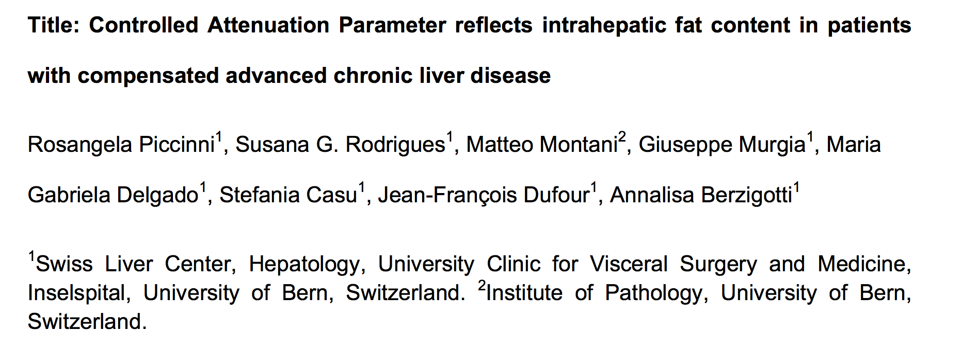

Slide 25
Controlled Attenuation Parameter reflects intrahepatic fat content in patients with compensated advanced chronic liver disease
*
Baveno VI, 2015
What it is known:
overweight/obesity and histologically steatosis are predictors of clinical decompensation in cACLD*
Berzigotti et al. Hepatology 2011
Everhart et al. Gastroenterology 2009
What it is unknow:
Does CAP in cACLD correctly mirror hepatic fat content?

Slide 26
Controlled Attenuation Parameter reflects intrahepatic fat content in patients with compensated advanced chronic liver disease
Aims:
To assess the accuracy of CAP for steatosis in patients with cACLD of any cause
To validate CAP IQR < 40 dB/m as good quality criterion in reducing errors

Slide 27
Controlled Attenuation Parameter reflects intrahepatic fat content in patients with compensated advanced chronic liver disease
Aims:
To assess the accuracy of CAP for steatosis in patients with cACLD of any cause
To validate CAP IQR < 40 dB/m as good quality criterion in reducing errors

Slide 28
Controlled Attenuation Parameter reflects intrahepatic fat content in patients with compensated advanced chronic liver disease
Methods:
Single center retrospective study
6/2015-6/2017
M or XL probe were used as
appropriate
On histology:
steatosis: S0 (<5%), S1 (5-33%) S2 (33-66%), S3 (>66%)
fibrosis ≥ F3 (metavir or equivalent) to confirm ACLD
Inclusion criteria:
Patients with liver biopsy
CAP measurement avaiable
LSM ≥ 10 kPa
Exclusion criteria:
LSM< 10 kPa
Any hepatic decompensation
No LSM/CAP avaiable in 6 mo.
LSM IQR/M>30

Slide 29
Controlled Attenuation Parameter reflects intrahepatic fat content in patients with compensated advanced chronic liver disease
461 biopsies for liver disease
No LS/CAP available= 161
LS <10kPa=141
Decompensation =12
aCLD= 147
No valid LS/CAP measurements (IQR/M)>30 = 18
Timelapse betweenm biopsy and CAP >6 months = 5
Study cohort population=124

Slide 30
Controlled Attenuation Parameter reflects intrahepatic fat content in patients with compensated advanced chronic liver disease
Results: 124 patients
etiology of liver disease
BMI median | 27.4
LS median | 16.3 (10-75)
CAP median | 272 (0-400)
IQR <40 | 60%
NAFLD/NASH | 30.5%
alcohol+metabolic/viral+metabolic | 15.2%
viral | 15.2%
autoimmune | 7.2%
alcohol | 4.2%
others | 12.4%

Slide 31
Controlled Attenuation Parameter reflects intrahepatic fat content in patients with compensated advanced chronic liver disease
Results: Study cohort population
Steatosis on LB | 69.4%
S1 | 33.9%
S2 | 19.4%
S3 | 16.1%
Almost exclusively seen in patients with NAFLD/NASH or metabolic syndrome+alcohol/viral disease

Slide 32
Controlled Attenuation Parameter reflects intrahepatic fat content in patients with compensated advanced chronic liver disease
Results: bridging fibrosis/cirrhosis on histology (73 pt)
Steatosis on LB | 75%
S2-S3 | 36%

Slide 33
Controlled Attenuation Parameter reflects intrahepatic fat content in patients with compensated advanced chronic liver disease
Results: CAP accuracy in entire population
CAP accuracy in bridging fibrosis/cirrhosis on histology (73 pt)
any steatosis | 0.827 (0.746-0.908) | p<0.0001
S2-S3 steatosis | 0.864 (0.796-0.93) | p<0.0001
any steatosis | 0.766 (0.631-0.900) | P=0.001
S2-S3 steatosis | 0.828 (0.727-0.930) | p<0.001

Slide 34
Controlled Attenuation Parameter reflects intrahepatic fat content in patients with compensated advanced chronic liver disease
Results: CAP and IQR
 | IQR ≥ 40 dB/m | IQR < 40 dB/m
any steatosis | 0.675 | 0.781
S2-S3 steatosis | 0.675 | 0.799

Slide 35
Controlled Attenuation Parameter reflects intrahepatic fat content in patients with compensated advanced chronic liver disease
Conclusion:
Steatosis is very frequent in patients with histologically confirmed advanced fibrosis and cirrhosis and clinical features of metabolic syndrome
CAP discriminative ability in this specific population is fair for steatosis and good for steatosis S2-S3
CAP IQR ≥ 40 dB/m should be considered an indicator of lower diagnostic accuracy in this setting

