Slide 1
Hepatitis B reactivation prophylaxis
Guidelines review
Élise Vuille-Lessard
Hepavisit 12.05.2021

Slide 2
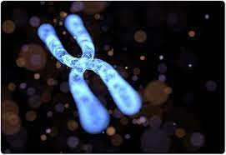
Definition of HBV reactivation
Loss of HBV immune control in anti-HBc–positive patients, HBsAg-positive or negative, receiving immunosuppressive therapy for a concomitant medical condition:
Rise in HBV DNA compared to baseline (or an absolute level of HBV DNA when a baseline is unavailable) (in HBsAg positive patients)
Reverse seroconversion (seroreversion) from HBsAg negative to HBsAg positive (in HBsAg-negative patients)
AASLD 2018
Notes:
cccDNA minichromosome in infected hepatocytes, which serves as a matrix for the synthesis of viral DNA and proteins. It persists in the nuclei of infected cells for many years, and fails to respond to ongoing treatment [1]. The presence of cccDNA has been shown even after the loss of the HBs antigen and seroconversion to anti-HBs, which explains why the eradication of HBV infection is impossible. cccDNA serves as a matrix for reactivation even in patients with a distant history of hepatitis B.
EASL 2017: not explicitely defined

Slide 3
Possible clinical manifestations
Silent reactivation: elevated viral load without overt hepatitis
HBV-associated hepatitis, elevated viral load and evidence of clinical, biochemical, or histological hepatitis
Fulminant liver failure, elevated viral load with hepatic synthetic dysfunction, encephalopathy, and coagulopathy.
Myint 2020
Notes:
cccDNA minichromosome in infected hepatocytes, which serves as a matrix for the synthesis of viral DNA and proteins. It persists in the nuclei of infected cells for many years, and fails to respond to ongoing treatment [1]. The presence of cccDNA has been shown even after the loss of the HBs antigen and seroconversion to anti-HBs, which explains why the eradication of HBV infection is impossible. cccDNA serves as a matrix for reactivation even in patients with a distant history of hepatitis B.
EASL 2017: not explicitely defined

Slide 4
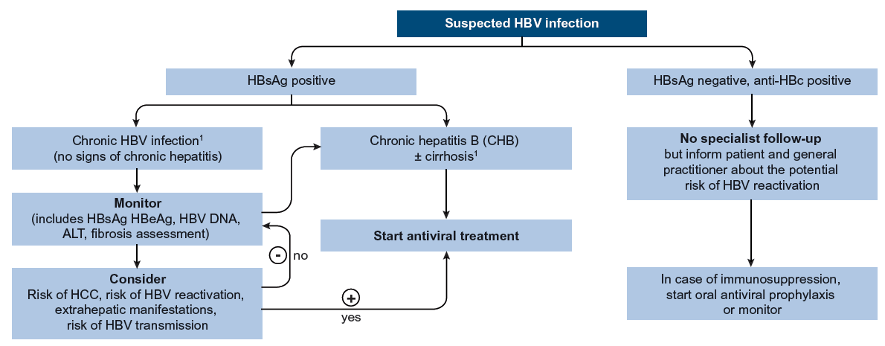
?
= On-demand therapy
Im Falle einer Immunsuppression oder Chemotherapie empfehlen wir, eine HBV-Reaktivierungsprophylaxe mit Tenofovir/Entecavir/Lamivudin zu evaluieren
EASL 2017

Slide 5
What is the risk?
Depends on risk factors: HBsAg(+), detectable DNA, anti-HBs (?), age, male, type and duration of IS
Immunosuppressive agent | Mechanism
Anti-CD20 | Destruction of HBV-specific B cells, decrease in the number of circulating anti-HBV antibodies, including neutralizing antibodies targeted against the HBs antigen
Glucocorticosteroids | Inhibitory effect on the synthesis of antiviral cytokines and the proliferation of lymphocytes
Inhibitors of cytokines, chemokines and integrins | Disrupt the synthesis of anti-inflammatory cytokines by active lymphocytes and other cells of the immune system
Inhibitors of tyrosine kinases | Suppress the activation and proliferation of lymphocytes through their effect on intracellular signalling pathways
Inhibition of the TNF-α pathway | ? Inhibits direct antiviral activity against cccDNA
Pawłowska 2019

Slide 6
What is the risk?
Rate of HBV reactivation from anticancer therapies:
41%-53% of HBsAg-positive, anti-HBc–positive patients
8%-18% of HBsAg-negative, anti-HBc–positive patients
Rate of HBV reactivation from antirheumatic therapies:
12.3% in HBsAg-positive, anti-HBc–positive patients
1.7% in HBsAg-negative, anti-HBc–positive patients
AASLD 2018

Slide 7
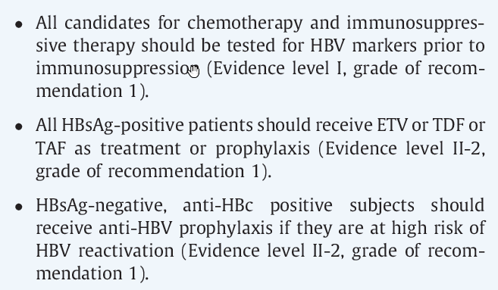
General recommendations
EASL 2017
AASLD 2018

Slide 9
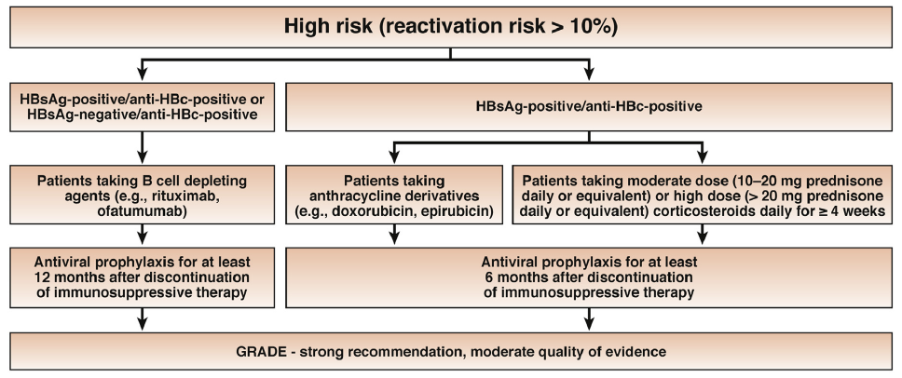
TACE?

Slide 10
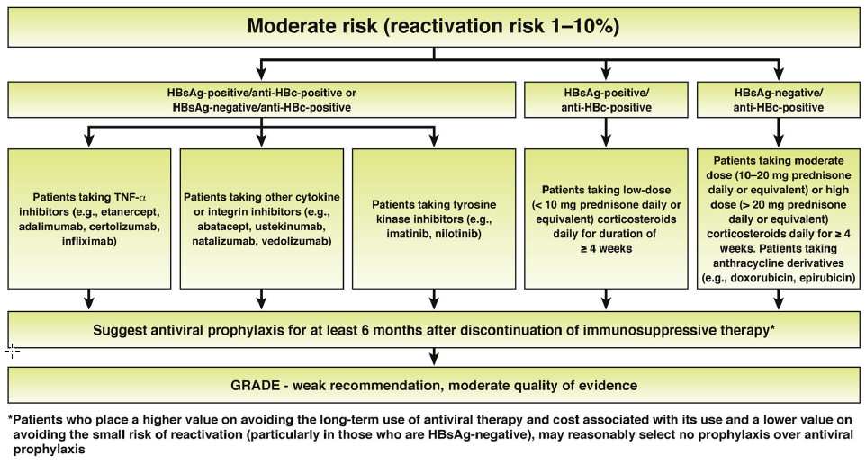
Calcineurin inhibitors
Potent vs. Non potent TNF
alpha-inhibitors?
(etanercept)

Slide 11
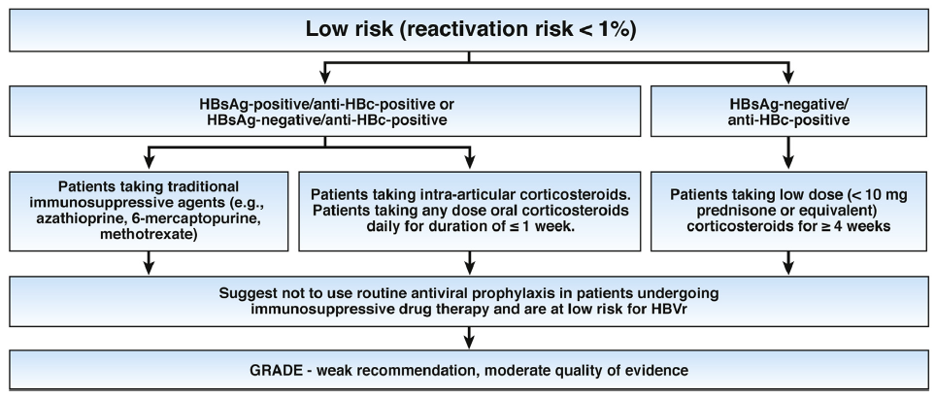

Slide 12
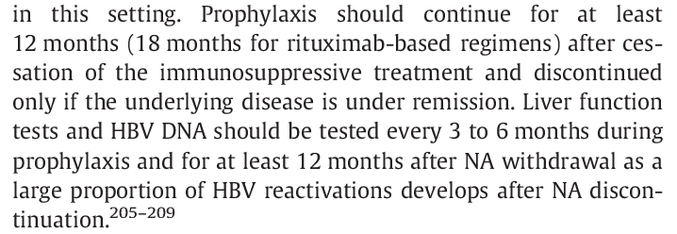
When / how long / how to monitor?
EASL 2017
With prophylaxis: monitoring while on prophylaxis not specified
AASLD 2018

Slide 13
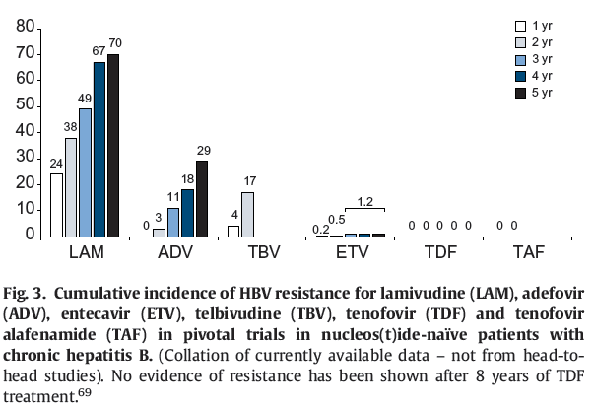
Which agent?
AASLD 2018
EASL 2017
AGA 2015
EASL 2017

Slide 14
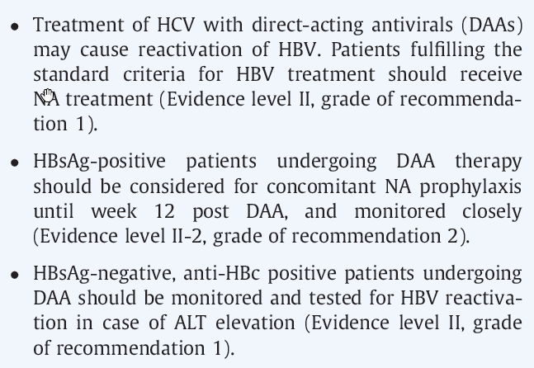
Prophylaxis while on DAA for HCV treatment
EASL 2017

Slide 15
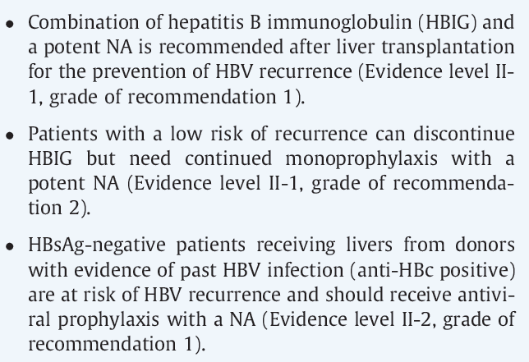
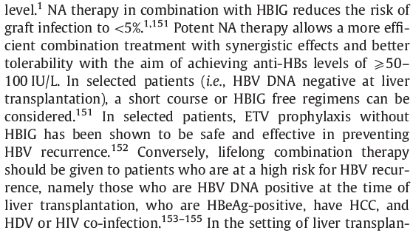
Post OLT
EASL 2017

Slide 16
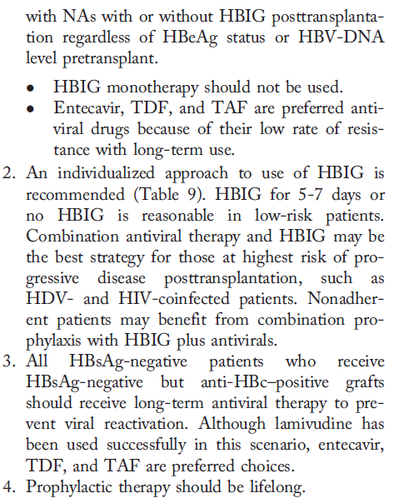
Post OLT
AASLD 2018

Slide 17
Post other solid organ tranplantation
EASL 2017
AASLD 2018

Slide 18
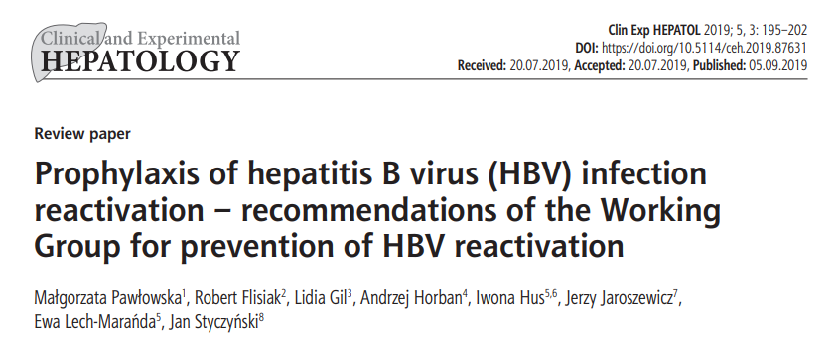
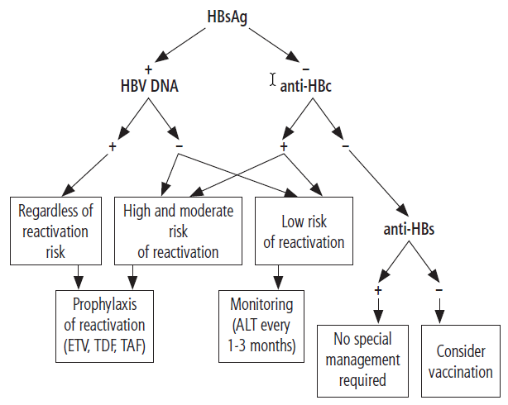
Lamivudine and other NAs (adefovir, telbivudine) are not recommended because of their weaker antiviral activity and the risk of selection of resistant strains, but they may be used in situations where ETV, TDF or TAF are not feasible therapeutic options.

Slide 19
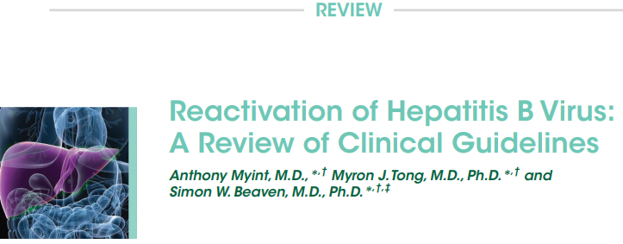
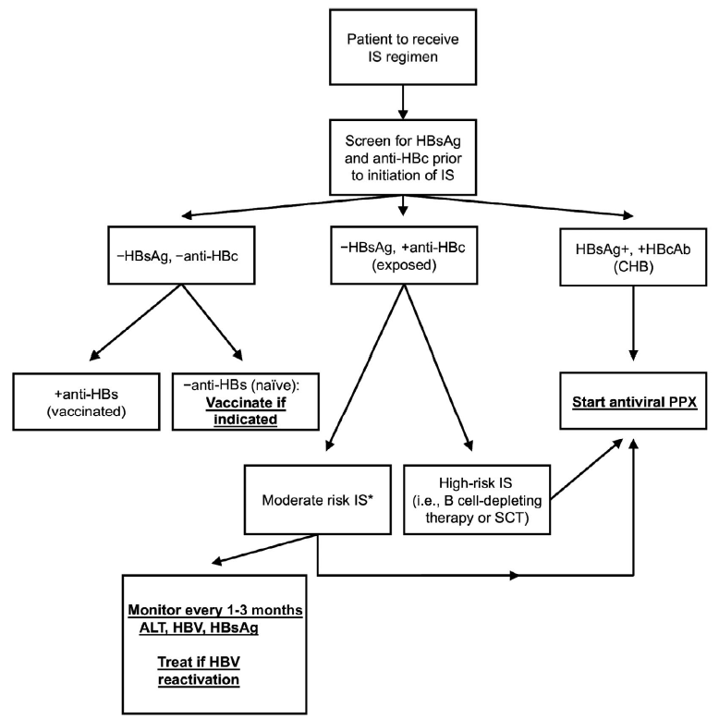
As for choice of antivirals, the majority of guidelines
recommend the nucleoside inhibitors tenofovir and entecavir
(ETV) as first-line therapy for both PPX and treatment,
citing several meta-analyses demonstrating higher efficacy
and barriers to resistance compared with lamivudine.

Slide 20
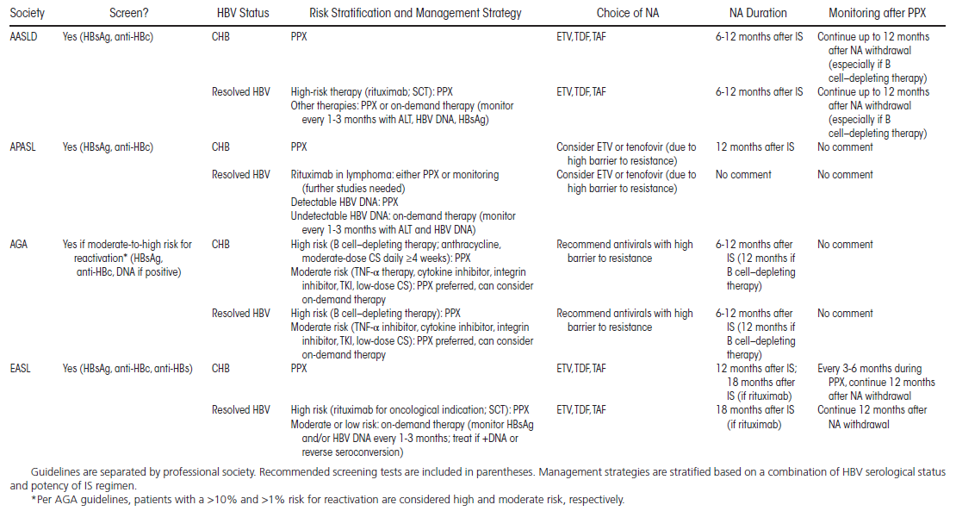
Myint 2020

Slide 21
Cost of both strategies?
Strategy | Cost (CHF) | Cost per year (CHF)
Prophylaxis with drug | Tenofovir disoproxil: 254/month Tenofovir alafenamid: 532/month Entecavir: 441/month Lamivudin: 103/month (+/- monitoring labs) | 3’000 16’000 5’300 1’200
Monitoring q3m (ALT, HBV DNA, HBsAg) with on-demand treatment | ALT: 2 CHF HBV DNA: 133 (53?) CHF HBsAg: 20 CHF Cost of a reactivation: ? Silent Hepatitis Fulminant hepatic failure | 620
www.compendium.ch
www.bag.admin.ch/al

Slide 22
Pros and cons
Strategy | Advantages | Disadvantanges
Prophylaxis with drug | Less frequent blood test Peace of mind | Take a pill a day Potential side effects (requires monitoring)
Monitoring q3m (ALT, HBV DNA, HBsAg) | No pill | Blood test every 3 month Risk of reactivation

Slide 23
Tenofovir alafenamide (TAF): less bone and renal effects than TDF
Notes:
https://www.ncbi.nlm.nih.gov/pmc/articles/PMC5316843/pdf/WJH-9-227.pdf

Slide 24
Summary
GIVE prophylaxis to high risk patients (all sAg pos + sAg neg on CD20/SCT)
DO NOT GIVE prophylaxis to low risk patients
MONITORING ALT, HBV DNA, HBsAg q3m + On-demand treatment
?Intermediate risk: Monitor vs. Prophylaxis
Until 6-12 months after end of IS (12-18 months if CD20)
Drugs with a high resistance barrier (Entecavir, TDF, TAF)
Post-OLT: NA +/- HBIG depending on risk

